Slide 1
Crimes in Atlanta, GA
- A Project In R by Sukhada Saoji and Nimish Ojale
Notes:
Hi everyone! I’m Nimish, and this is Sukhada. We will be presenting our work on the Crimes in Atlanta database. This database has been acquired from the Atlanta PD, and our goal is to study the data, come up with important inferences, and build a model to predict the occurrence of a particular crime.

Slide 2
The agenda
Motivation
Exploring the data
Objective
Cleaning and Feature selection
Methods for Predictive modeling
Implementation
Future work
Notes:
So today we will be starting with explaining the reason why we chose this data set for our project. We will explore the data to try and find out how it is distributed against several variables.
Then we will begin our analysis by cleaning the data and choosing important predictors.
We will consider several classification methods for our analysis, and compare them to each other.
We will then discuss the coding part of the project and the results we obtained.
Finally, we will see where we can improve, and I would love to get suggestions from you guys about how we can improve our accuracy.

Slide 3
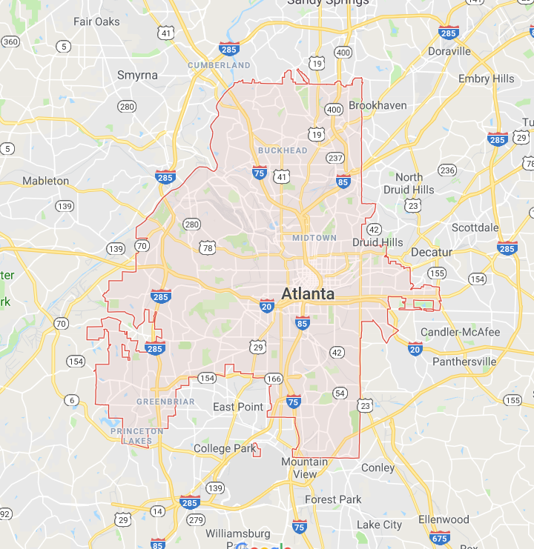
Motivation
6th most crime-ridden city in the United States ^{[1]}
Rate of crime = more than twice of national average
Notes:
So the motivation behind choosing this project was that Atlanta is one of the most crime-ridden cities in the US, with the rate of crime more than twice that of the national average.

Slide 4
Motivation
Chances of a violent crime against you = 5.2/100
Chances of a property crime against you = 25.556/100
Notes:
If you’re planning to travel to Atlanta over the summer, I don’t want to discourage you, but I guess carrying a pepper spray would be safer. As you can see, you are more than 5% likely to be the victim of a violent crime, and more than 25% likely to be subjected to property crimes.

Slide 5
Know thy data
Crime data dump collected in 2017
26760 data points
23 fields
Several fields with UNK value
Notes:
Moving on to the data, we have the data collected in the year 2017 by Atlanta PD. There are more than 26000 reported crimes, with 23 fields that represented the occurrence time, location, apartment numbers, etc.

Slide 6
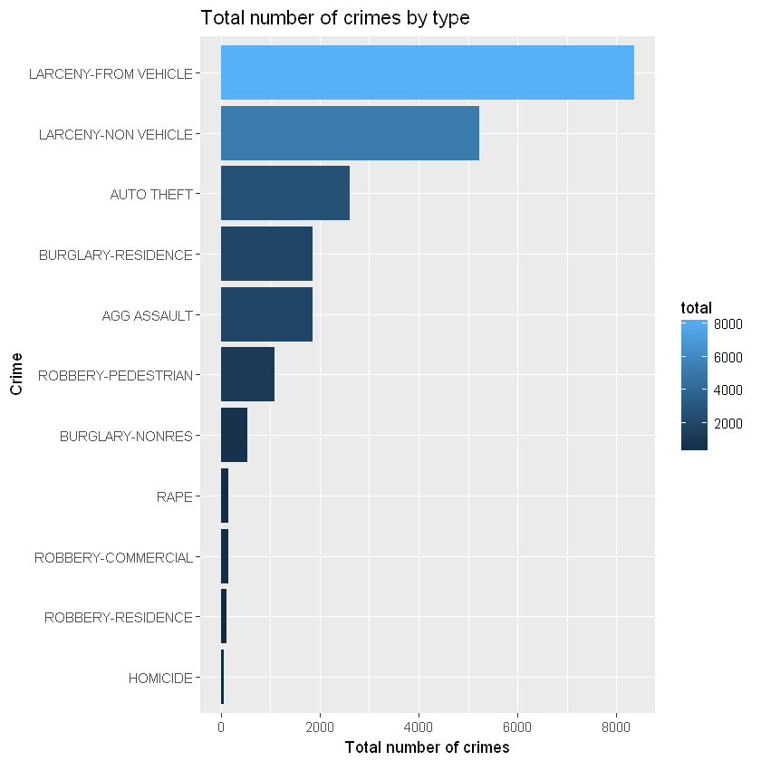
Let there be exploration
Notes:
Now we will try to study the data and analyze the trends. Here is a plot of the number of crimes divided by the type of crime.
As we can see, theft from vehicles ranks at the top with more than 8000 instances in the past year.

Slide 7
Let there be exploration
Notes:
This plot shows us the breakdown of the crimes with neighborhoods.
Downtown ranks at the top. In this database we have more than 230 unique values.

Slide 8
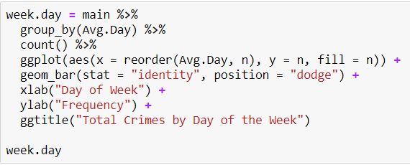
Let there be exploration
Notes:
Saturday is when the mst number of crimes take place.

Slide 9
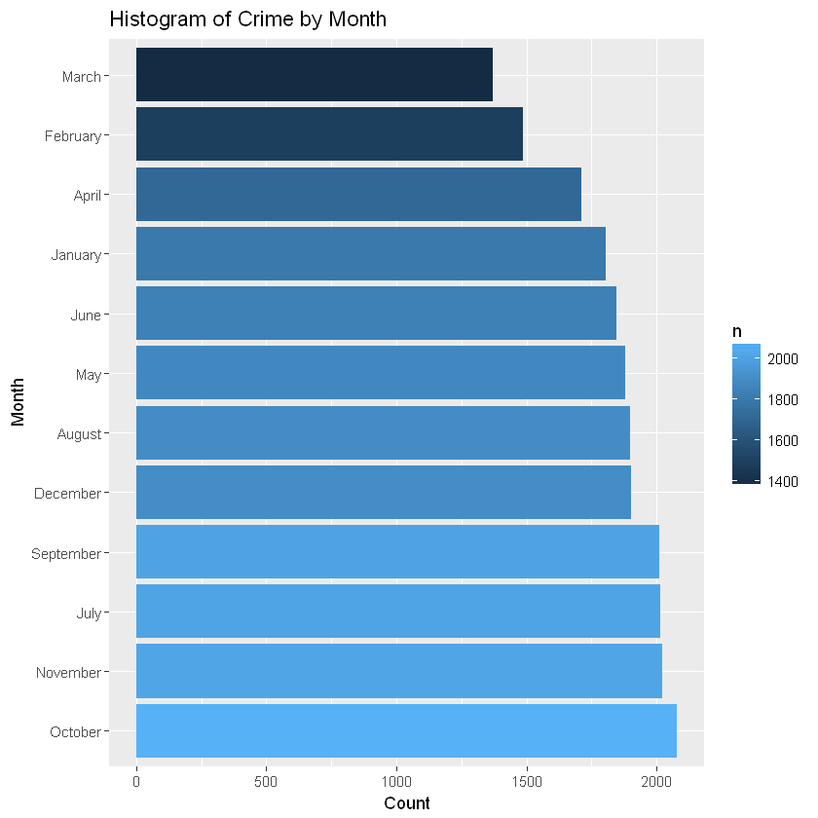
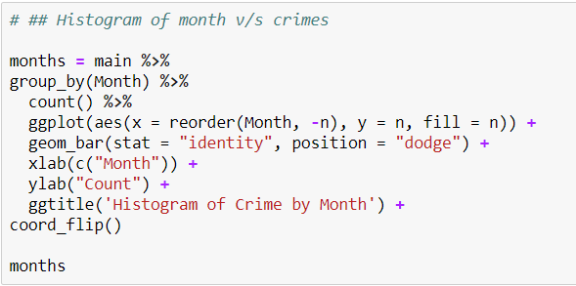
Let there be exploration

Slide 10
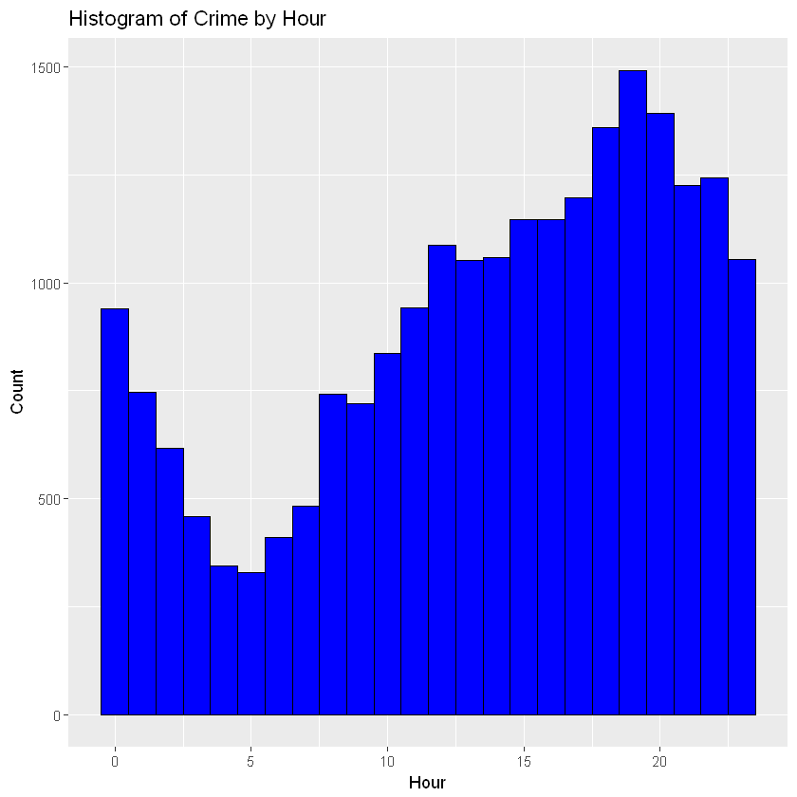
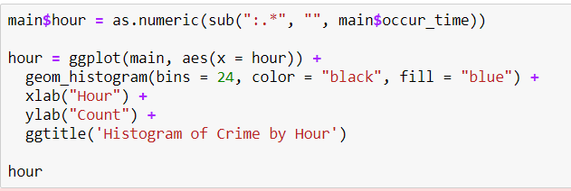
Let there be exploration
Notes:
More number of crimes are committed during the evening and night, while the numbers taper down in the morning.

Slide 11
Let there be exploration
Notes:
Larceny from vehicle is the obvious winner here, as we saw earlier.

Slide 12
Objective
Build model to predict probability of occurrence of a particular crime
Predictors?
Neighborhood
Month
Time of the day
Day of the week
Shift

Slide 13
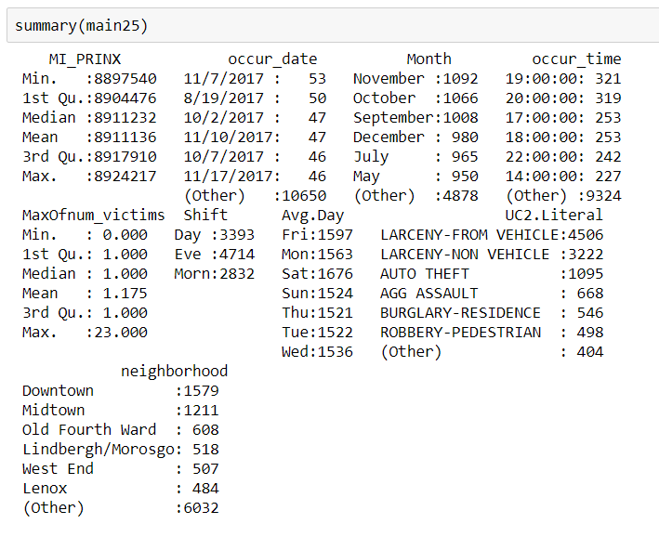
Cleaning and Feature Selection
Removed Unk and NaN values
Rows brought down from 26760 to 10939
Top 25 most crime-ridden neighborhoods only
Removed insignificant predictors like beat, location type, offense id, apt no.
Factorized variables like Shift, neighborhood, and UC2.Literal

Slide 14
Predictive modeling
Multinomial Logistic Regression
Discriminant Analysis
K-Nearest Neighbors
Random Forest
Neural Networks
Notes:
So for model building we will be considering the following classification methods

Slide 15
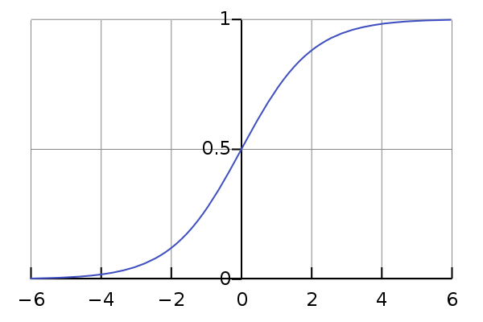
Multinomial Logistic Regression
Logistic Regression with more than two classes
Split data into Training set and Validation set
Library(‘nnet’)

Slide 16
Results of Multinomial Logistic Regression
Overall accuracy (Confusion Matrix) = 41.45%
Accuracy for detecting Larceny from vehicle = 87.343%
Notes:
Accuracy for detecting larceny is high

Slide 17
Linear Discriminant Analysis
Approximate Bayes’ Classifier
Decision boundary is a function of a linear combination of known observations
Assumptions:
Normally distributed observations
Homoscedasticity
Notes:
Moving on to discriminant analysis, this is a method that approximates a Bayes classifier. LDA assumes that the observations are normally distributed, and variances of individual observations are equal.

Slide 18
Applying LDA
lda() function
Overall accuracy (Confusion Matrix) = 41.43%
Accuracy for detecting Larceny from vehicle = 88.76%
Notes:
Accuracy is close to the logit regression model

Slide 19
Quadratic Discriminant Analysis
Decision boundary is a function of a quadratic combination of known observations (Σk is covariance matrix)
Assumptions:
Normally distributed observations
Heteroscedasticity
Notes:
QDA works identically as LDA: except that it estimates separate variance for each class
Discriminant function is quadratic– boundary is quadratic
More flexible than LDA
Works best when we have different variances in every class and enough large no of obs

Slide 20
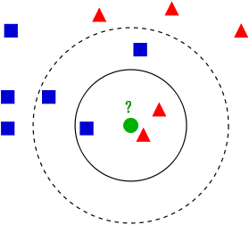
K-Nearest Neighbors
Non-parametric learning method
Classifies test observation into class that is “most frequent” among k nearest neighbors
Notes:
Step 1: identify the 𝐾points in the training data that are closest to 𝑥0, i.e., the “𝐾nearest neighbors”.
➢Step 2: calculate the fraction of observations belonging to each class among the 𝐾points.
➢Step 3: assign this observation to the class with the largest fraction.
Though KNN is a very simple approach, it can often perform surprisingly well, close to the Bayes classifier.
𝐾=1: decision boundary is flexible
➢As 𝐾grows, the boundary becomes less flexible and gets close to linear.
➢1/𝐾represents the level of flexibility.
Use the knn() function in the classlibrary, which requires 4 inputs.
➢This function does not follow the two-step (first model fitting, then prediction) approach; it generates predictions using a single command.
Optimal value by minimum test MSE

Slide 21
Random Forest
Tree-based method
Improvement over Bagging – Decorrelates the bootstrapped trees
Choose ‘m’ predictors for each bootstrapped sample, m= √p for classification
Specially effective for a dataset with large variance in number of data points in each response class
Notes:
Decision trees suffer from high variance!
If we randomly split the training data into 2 parts, and fit decision trees on both parts, the results could be quite different.
Three methods to improve trees: Bagging, Random forests, Boosting
Bagging typically improves the accuracy over prediction using a single tree, but it is now hard to interpret the model!
Build a number of decision trees on bootstrapped training sample,
•For each tree, each time a split in a tree is considered, a random sample of 𝒎 predictors is chosen as split candidates from among the 𝑝 predictors. (Usually 𝒎=root 𝒑is used for classification)
It builds on the idea of bagging,but it provides an improvement because it de-correlates the trees
Suppose that we have a very strong predictor in the data set along with a number of other moderately strong predictor, then in the collection of bagged trees, most or all of them will use the very strong predictor for the first split!
➢All bagged trees will look similar. Hence all the predictions from the bagged trees will be highly correlated.
➢Averaging many highly correlated quantities does not lead to a large variance reduction, and thus random forests “de-correlates”the bagged trees leading to more reduction in variance.

Slide 22
RANDOM FOREST RESULTS
Mtry= root(p)=3 for classification
Identified important predictors
Applied 5 fold cross validation with 2 repetitions
Accuracy on train data= 50%, test data =42%

Slide 23
RANDOM FOREST RESULTS
Confusion Matrix & Test Accuracy
Train Accuracy

Slide 24
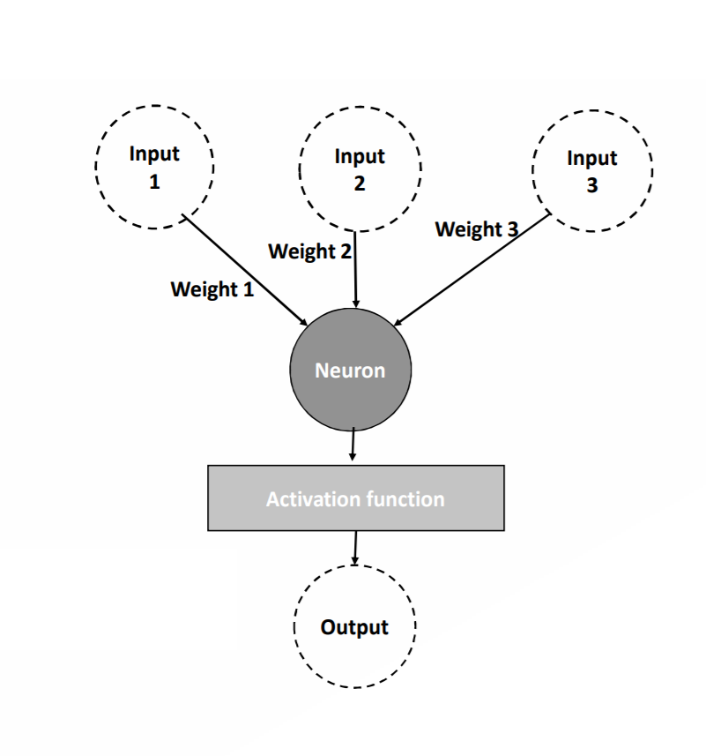
ARTIFICIAL NEURAL NETWORK
Neurons, Nodes/Units: Individual, interconnected units
Receives input from one or more sources being other neurons or data input
Data:
Binary, integers or real (floating point) values
Nominal variable should be encoded with binary variables
Node multiplies inputs by a weight
Passes the sum to an activation function
Output Function:
x: input, w: weight, p: inputs, ø: activation vector
An Artificial Neuron
Notes:
We will discuss how neurons or nodes form weighted connections, how neurons create layers, and how activation functions affect the output of a layer.

Slide 25
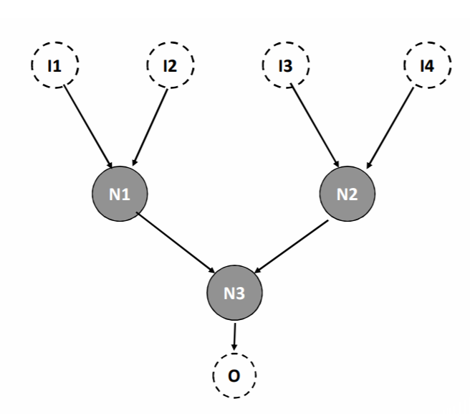
BASIC ANN ARCHITECTURE
Hidden nodes:
Input from other nodes – input / hidden node
Output to other nodes, as output / hidden nodes
Nodes of a single layer have same properties: Activation function and type: input, hidden / output
Bias Nodes can be added to help learn pattern: input node with constant value output
Input Layer
Hidden Layer
Output Layer
An artificial neural network with four layers of input nodes {I1,I2, I3, I4}, hidden nodes {N1, N2}, {N3} and output node {O}
Notes:
there are three neurons. Now the activation
functions and intermediate outputs are included implicitly in the nodes
and weights in arcs (connections) between nodes. The strucure in Fig.
2.2 could still be a part of a larger network. The input and output are
often a special type of neurons, either to accept input data or to
generate output values of the network.
Bias nodes are added to feedforward neural networks to help these
learn patterns. Bias nodes function like an input node that always
produces constant value 1 or other constant. Because of this property,
they are not connected to the previous layer. The constant 1 here is
called the bias activation. Not all neural networks have bias nodes. Fig.
2.4 depicts a two-hidden-layer network with bias nodes. The network
includes three bias nodes. Bias neurons allow the output of an
activation function to be shifted. This will be presented later on, in the
context of activation functions.
Regardless of the type of neuron, node or processing unit, neural
networks almost always are constructed of weighted connections
between these units.

Slide 26
ACTIVATION FUNCTION
Activation or transfer functions establish bounds for the output of neurons
Linear function
Step activation function
Sigmoid or Logistic activation function
Hyperbolic tangent function
Rectified Linear Unit (ReLU)
Softmax function
Notes:
Linear-identity mapping
Step : outputs value 1 for inputs of 0.5 or greater and 0 for all
other values. Step functions are also called threshold functions because
they only return 1 (true) for those values above some threshold given,
e.g., according to Fig. 2.7(a). The next phase is to form a ”ramp” as in
The sigmoid or logistic activation function is a very common choice for
feedforward neural networks that need to output only positive values.
. Values between 0 and 1.
The hyperbolic tangent function is also one of the most important
activation functions. It is restricted into the range between -1 and 1.
rectified linear unit (ReLU). It is
simple and seen a good choice for hidden layers. rectified linear unit comes partly from that it is a
linear, non-saturating function. Unlike the sigmoid or hyperbolic
tangent activation functions, ReLU does not saturate to -1, 0 or 1.
The final activation function is the softmax function. Along with the
linear function, softmax is usually found in the output layer of a neural
network. The node that has the greatest value claims the input as a
member of its class. Because it is a preferable method, the softmax
activation function forces the output of the neural network to
represent the probability that the input falls into each of the classes.
Without the softmax, the node’s outputs are simply numeric values,
with the greatest indicating the winning class. When using softmax, the output of a single node is dependent
on the other output nodes.
neural network applying the softmax
activation function, this allows the network to give the probability that
these measurements belong to each of three species. For example,
their probabilities could be 80%, 15% and 5%.

Slide 27
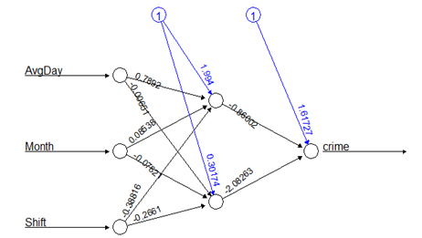
ANN APPLICATION FOR CRIME DETECTION
Categorical response and predictors are coded as binary variables
Only the significant predictors are considered
Data is normalized before analysis
Achieved Accuracy: 49.91%
Package; Neuralnet, Hidden Layer=2, Error Function= Sum of Squares of Error
Error: 0.5119 Steps: 106

Slide 28
Future WORK
Improving prediction accuracy of Multinomial Logit, LDA, QDA models
Multiclass SVM model
Gradient boosting algorithms - MART
Notes:
SVM is a binary classifier.
Can be used for multiclass woth one Vs all approach and encoding variables as binary.
Gradient boosting is a machine learning technique for regression and classification problems, which produces a prediction model in the form of an ensemble of weak prediction models, typically decision trees. It builds the model in a stage-wise fashion like other boosting methods do, and it generalizes them by allowing optimization of an arbitrary differentiable loss function.

Slide 29
REFERNCES
Wikipedia
Prediction of crime occurrence from multimodal data using deep learning, Hyeon-Woo Kang, Hang-Bong Kang*, Dept. of Digital Media, Catholic University of Korea, Bucheon, Gyonggi-Do, Korea
Multinomial Logistic Regression, Dr. Jon Starkweather and Dr. Amanda Kay Moske
An Introduction to Statistical Learning with Applications in R, Authors: James, G., Witten, D., Hastie, T., Tibshirani, R.
https://github.com/priyanka21sk/LA-Crime-Data-Analysis-using-R
https://www.r-bloggers.com/san-francisco-crime-data-analysis-part-1
https://rpubs.com/Ravinderkhatri/crimetrends
http://www.utexas.edu/courses/schwab/sw388r7/SolvingProblems/
http://statweb.stanford.edu/~jhf/MART.html
www.analyticsvidhya.com

Slide 30
QUESTIONS ?

