Slide 1
Inequality in Latin America
Joshua Winter | Statistical Computing | April 13, 2018

Slide 2
Background
Latin America is a vital part of the world economy responsible for producing numerous products essential to our everyday lives such as textiles, food and agriculture, and natural resources.
For decades, it has been among the most unequal regions in the world, particularly with regard to income distribution and social welfare.
However, since the late 1990’s inequality has declined based on nearly all available metrics.
Numerous economists and policy makers have attempted to understand why; the vast majority coming up with slightly different conclusions.

Slide 3
perspectives on the decline
Lower inflation rates (Perry, Lopez).
Strong GDP growth, higher tax revenues, and increased foreign direct investment (Tsounta and Osueke).
Increase in the working age population relative to people of non-working age (Addison).
Establishment of conditional (such as sending your child to school) cash transfer programs (Loyka).
Higher participation rate of the poor in the workforce (Addison).
Use of income redistribution programs and industrial privatization (Cornia, Martorano).
Decline in in the informal sector workforce(Acemoglu).
Decline in wage premium for education (Addison).
More stable monetary and fiscal policy collectively as a region (Perry, Lopez).

Slide 4
Measurements of Inequality
Several methods exist, all attempting to compare the distribution of resources by intelligence agents in the market with a maximum entropy random probability distribution.
Atkinson
Gini
Theil
Generalized Entropy Index
Maximum Entropy Random Probability Distribution.
Distribution with largest entropy should be chosen as least informative.
Minimizes the amount of prior information built into the distribution.
Many physical systems tend to move towards maximal entropy configurations over time.
Notes:
Information entropy is defined as the average amount of information produced by a stochastic source of data.
Atkinson has proposed another class of inequality measures that are used from time to time. This class also has a weighting parameter ε (which measures aversion to inequality) and some of its theoretical properties are similar to those of the extended Gini index. Intuitively, this Index tells us how much income we are disposed to give up in order to have equal incomes. Y=income of an individual, m is the average. The index is subgroup decomposable.^{[2]} This means that overall inequality in the population can be computed as the sum of the corresponding Atkinson indices within each group, and the Atkinson index of the group mean incomes (bottom).
Theil
Generally the situation is characterized by a continuous distribution function f(k) (supported from 0 to infinity) where f(k) dk is the fraction of the population with income k to k + dk.

Slide 5
Atkinson Method and Thiel Index
Atkinson: Useful in determining which end of the distribution contributed most to the observed inequality fluctuations (think weighted). Focus is more on social welfare than income
Theil Index: Measure of redundancy, lack of diversity, isolation, segregation, inequality, non-randomness, and compressibility. Calculated as the maximum possible entropy of the data minus the observed entropy.
Notes:
Information entropy is defined as the average amount of information produced by a stochastic source of data.
Atkinson has proposed another class of inequality measures that are used from time to time. This class also has a weighting parameter ε (which measures aversion to inequality) and some of its theoretical properties are similar to those of the extended Gini index. Intuitively, this Index tells us how much income we are disposed to give up in order to have equal incomes. Y=income of an individual, m is the average. The index is subgroup decomposable.^{[2]} This means that overall inequality in the population can be computed as the sum of the corresponding Atkinson indices within each group, and the Atkinson index of the group mean incomes (bottom).
Theil
Generally the situation is characterized by a continuous distribution function f(k) (supported from 0 to infinity) where f(k) dk is the fraction of the population with income k to k + dk.

Slide 6
Gini coefficient
Measure of statistical dispersion used to represent the frequency distribution in terms of the wealth of a country’s residents.
The most commonly used metric for inequality.
U.S. Gini: .469 ( 115th in the world)
Top 3 (.23-.24) : Finland, Faroe Islands, Slovakia
Bottom 3 (.60-.61): South Africa, Micronesia, Haiti
The Gini Coefficient is considered to be one of the most standard methods of calculating inequality. Largely, this is due to it being simpler to understand compared to the Atkinson or Thiel methods.
Notes:
The Gini coefficient is usually defined mathematically based on the Lorenz curve, which plots the proportion of the total income of the population (y axis) that is cumulatively earned by the bottom x% of the population (see diagram). The line at 45 degrees thus represents perfect equality of incomes. The Gini coefficient can then be thought of as the ratio of the area that lies between the line of equality and the Lorenz curve (marked A in the diagram) over the total area under the line of equality (marked A and B in thCe diagram). For large populations, the Gini is calculated using a CPDF.
Lorenz Curve
The curve is a graph showing the proportion of overall income or wealth assumed by the bottom x% of the people, although this is not rigorously true for a finite population (see below). It is often used to represent income distribution, where it shows for the bottom x% of households, what percentage (y%) of the total income they have. The percentage of households is plotted on the x-axis, the percentage of income on the y-axis. It can also be used to show distribution of assets. In such use, many economists consider it to be a measure of social inequality.
EQ 1: half of the relative mean absolute difference, which is mathematically equivalent to the Lorenz curve definition.^{[15]} The mean absolute difference is the average absolute difference of all pairs of items of the population, and the relative mean absolute difference is the mean absolute difference divided by the average, to normalize for scale. if x_{i} is the wealth or income of person i, and there are n persons, then the Gini coefficient G is given by: see chart.
CPDF: When the income (or wealth) distribution is given as a continuous probability distribution function p(x), where p(x)dx is the fraction of the population with income x to x+dx, then the Gini coefficient is again half of the relative mean absolute difference. where μ is the mean of the distribution and the lower limits of integration may be replaced by zero when all incomes are positive.

Slide 7
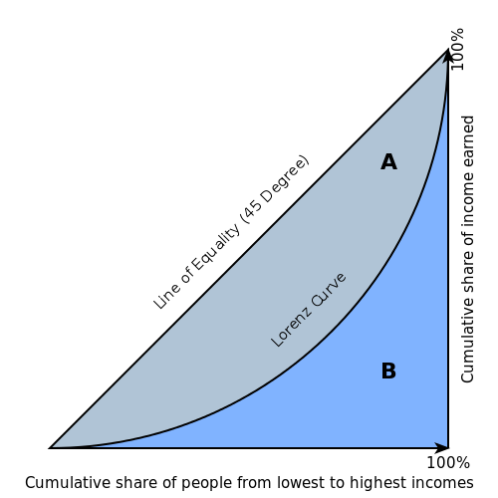
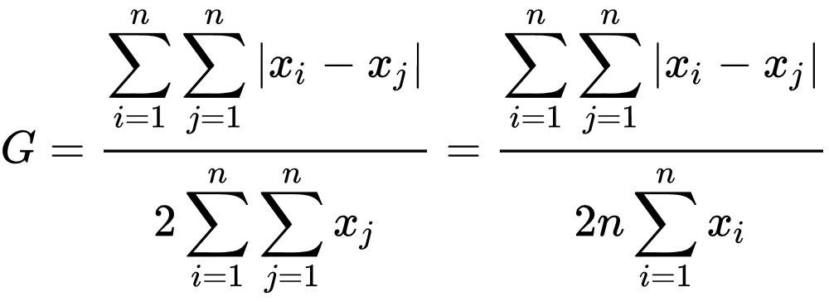
Gini coefficient Cont’d
Lorenz Curve: Graphical representation of the CDF of the empirical probability distribution of wealth or income.
For small populations, such as islands, it is calculated as half the relative mean absolute difference .
Larger populations, however, use a continuous probability distribution function.
Notes:
The Gini coefficient is usually defined mathematically based on the Lorenz curve, which plots the proportion of the total income of the population (y axis) that is cumulatively earned by the bottom x% of the population (see diagram). The line at 45 degrees thus represents perfect equality of incomes. The Gini coefficient can then be thought of as the ratio of the area that lies between the line of equality and the Lorenz curve (marked A in the diagram) over the total area under the line of equality (marked A and B in thCe diagram). For large populations, the Gini is calculated using a CPDF.
Lorenz Curve
The curve is a graph showing the proportion of overall income or wealth assumed by the bottom x% of the people, although this is not rigorously true for a finite population (see below). It is often used to represent income distribution, where it shows for the bottom x% of households, what percentage (y%) of the total income they have. The percentage of households is plotted on the x-axis, the percentage of income on the y-axis. It can also be used to show distribution of assets. In such use, many economists consider it to be a measure of social inequality.
EQ 1: half of the relative mean absolute difference, which is mathematically equivalent to the Lorenz curve definition.^{[15]} The mean absolute difference is the average absolute difference of all pairs of items of the population, and the relative mean absolute difference is the mean absolute difference divided by the average, to normalize for scale. if x_{i} is the wealth or income of person i, and there are n persons, then the Gini coefficient G is given by: see chart.
CPDF: When the income (or wealth) distribution is given as a continuous probability distribution function p(x), where p(x)dx is the fraction of the population with income x to x+dx, then the Gini coefficient is again half of the relative mean absolute difference. where μ is the mean of the distribution and the lower limits of integration may be replaced by zero when all incomes are positive.

Slide 8
Nora Lustig
Professor of Latin American Economics at Tulane University.
Originally from Argentina.
Worked for Brooking Institution and was founder of the Latin American and Caribbean Economic Association.
Most notably she has collaborated with the World Bank conducting research relating to Latin American inequality.
Key Articles:
”The decline in inequality in Latin America”
“The rise and fall of income inequality in Latin America”
“Deconstructing the decline of inequality in Latin America”
Notes:
Very few of the authors and papers surveyed directly mentioned trade in their explanations for the decline in inequality.

Slide 9
Overview of research
Conducted beginning in 2009 and finished in 2013.
Time period(s) researched: 1980’s-2010. Although there is some deviation.
Looked at changes over time to in-country variables such as education, government transfers, wage premiums, and institutions.
Done at a macro level focusing on the region as a whole rather than individual countries
Semi-focus on Mexico, Peru, Argentina, and Brazil; four of the largest economies in the region.
Due in part to lack of data on others and that Mexico, Argentina, Brazil, and Peru have seen relatively large declines in terms of inequality in recent years.
Notes:
Very few of the authors and papers surveyed directly mentioned trade in their explanations for the decline in inequality.

Slide 10
Lustig’s analysis
From 2000-2009 the Gini decreased in 13/17 LA countries with comparable data.
Regionally speaking, it decreased from .529-.509.
Stronger labor institutions and greater concern for social issues.
Fall in the wage premium for skilled workers.
Increased educational spending, attainment, educational mobility.
Decline of non-labor income inequality is directly linked to fiscal policy.
The decline in inequality accounted for about a third of the decline of the decline in extreme poverty, the remaining two-thirds were accounted for by economic growth.
Notes:
Very few of the authors and papers surveyed directly mentioned trade in their explanations for the decline in inequality.

Slide 11
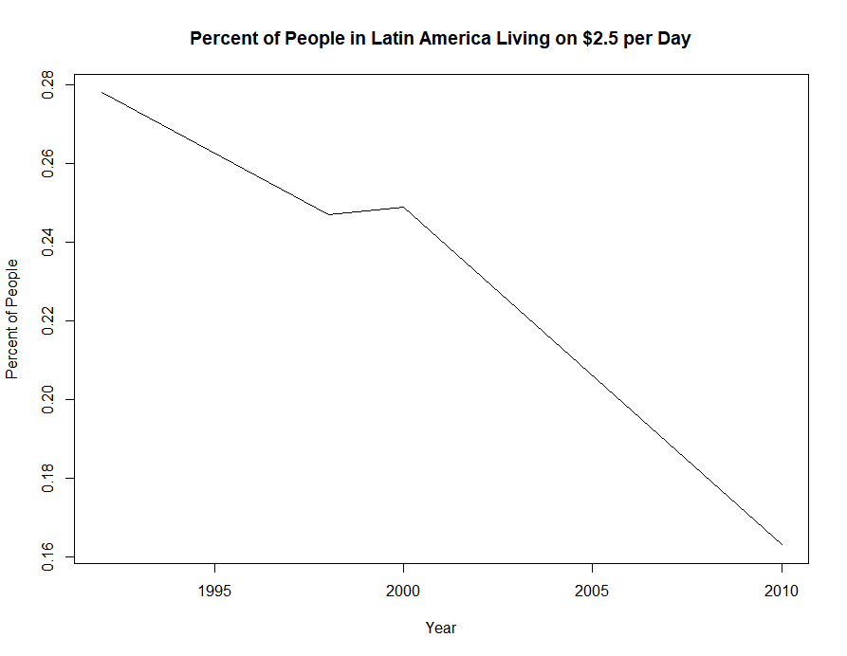
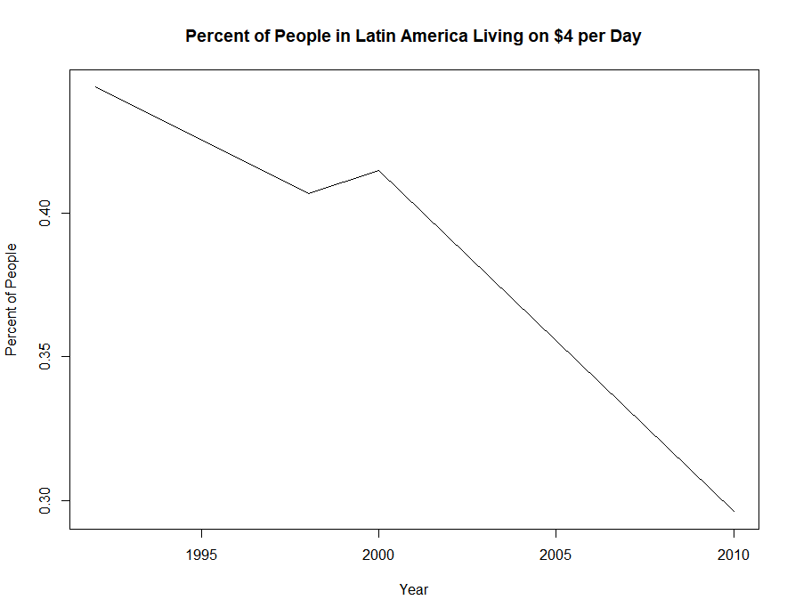
Poverty in latin america
Notes:
Very few of the authors and papers surveyed directly mentioned trade in their explanations for the decline in inequality.

Slide 12
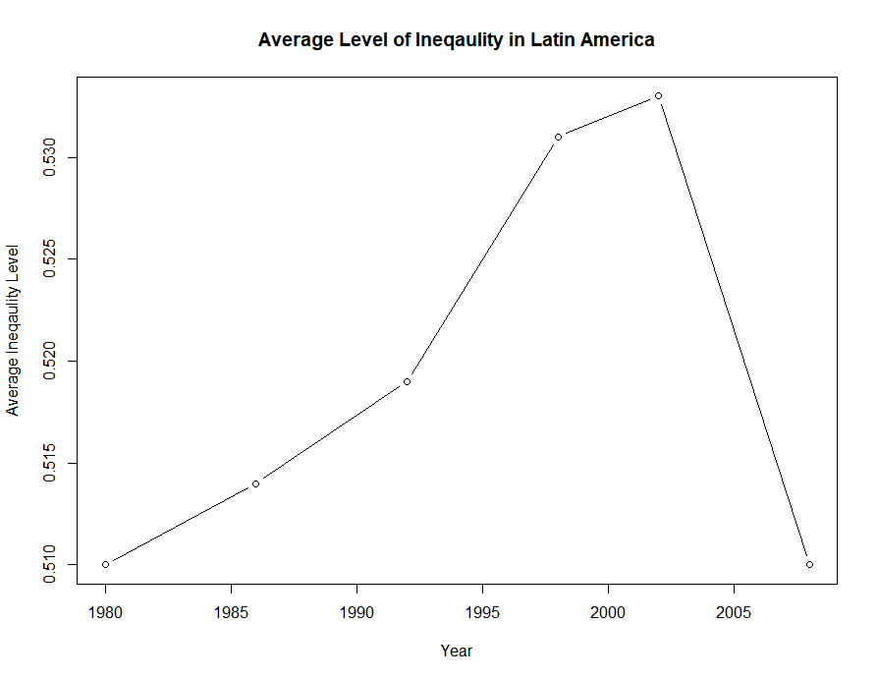
Average Level of Inequality 1980-2010
Obs. Year Avg. Gini
1 1980 0.510
2 1986 0.514
3 1992 0.519
4 1998 0.531
5 2002 0.533
6 2008 0.508

Slide 13
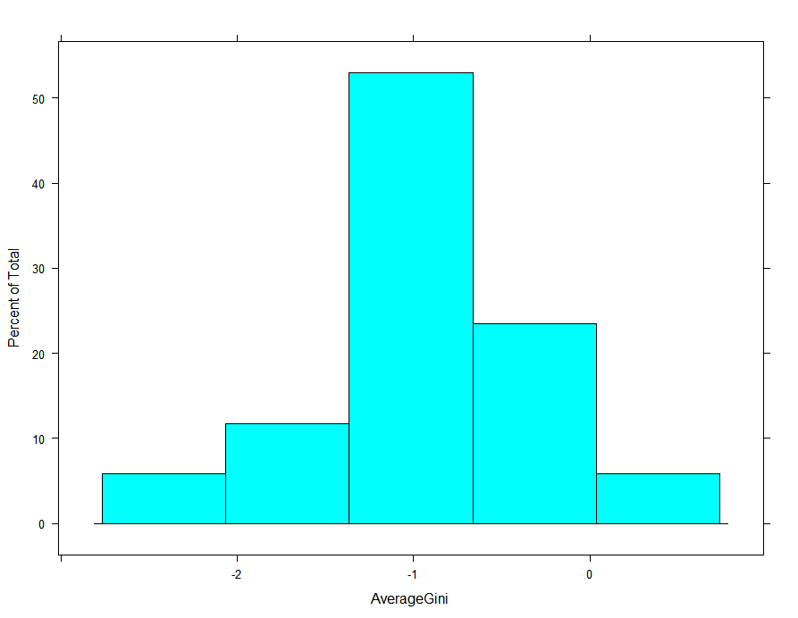
Change in inequality 2000-2010
Country Average Annual Change in Gini 2000-2010 (in Percent)
1 Argentina -1.30
2 Bolivia -2.05
3 Brazil -1.03
4 Chile -0.72
5 Costa Rica -0.47
6 Dominican Republic -0.79
7 Ecuador -1.99
8 El Salvador -1.24
9 Guatemala -0.10
10 Honduras 0.61
11 Mexico -1.17
12 Nicaragua -2.64
13 Panama -0.74
14 Paraguay -0.39
15 Peru -0.91
16 Uruguay -0.20
17 Venezuela -1.07
Country Average Annual Change in Gini 200-2010 (in Percent)
Length:17 Min. :-2.6400
Class :character 1st Qu.:-1.2400
Mode :character Median :-0.9100
Mean :-0.9529
3rd Qu.:-0.4700
Max. : 0.6100

Slide 14
Average change in inequality vs education
Country Gini Secondary Primary Tertiary Average change in Return to Education (P,S,T) 2000-2010
1 Argentina -0.0130 -0.030 0.013 -0.037 -0.018000000
2 Bolivia -0.0205 -0.040 0.020 -0.028 -0.016000000
3 Brazil -0.0103 -0.035 -0.049 -0.022 -0.035333333
4 Chile -0.0072 -0.035 -0.035 0.000 -0.023333333
5 Costa Rica -0.0047 0.022 -0.037 0.015 0.000000000
6 Dominican Republic -0.0079 -0.008 0.008 -0.021 -0.007000000
7 Ecuador -0.0199 -0.002 -0.010 -0.050 -0.020666667
8 El Salvador -0.0124 -0.019 -0.022 0.028 -0.004333333
9 Guatemala -0.0010 0.005 0.020 0.021 0.015333333
10 Mexico -0.0117 0.010 -0.043 -0.025 -0.019333333
11 Nicaragua -0.0264 -0.007 -0.030 -0.017 -0.018000000
12 Panama -0.0074 -0.003 0.020 -0.017 0.000000000
13 Paraguay -0.0039 -0.025 -0.075 -0.010 -0.036666667
14 Peru -0.0091 0.013 -0.060 -0.023 -0.023333333
15 Uruguay -0.0020 0.020 0.018 -0.012 0.008666667
16 Venezuela -0.0107 -0.035 -0.033 0.007 -0.020333333
> summary(gini_and_ed)
Country Gini Secondary Primary Tertiary
Length:16 Min. :-0.026400 Min. :-0.04000 Min. :-0.07500 Min. :-0.05000
Class :character 1st Qu.:-0.012550 1st Qu.:-0.03125 1st Qu.:-0.03850 1st Qu.:-0.02350
Mode :character Median :-0.009700 Median :-0.00750 Median :-0.02600 Median :-0.01700
Mean :-0.010506 Mean :-0.01056 Mean :-0.01844 Mean :-0.01194
3rd Qu.:-0.006575 3rd Qu.: 0.00625 3rd Qu.: 0.01425 3rd Qu.: 0.00175
Max. :-0.001000 Max. : 0.02200 Max. : 0.02000 Max. : 0.02800
Average change in Return to Education (P,S,T) 2000-2010
Min. :-0.03667
1st Qu.:-0.02133
Median :-0.01800
Mean :-0.01365
3rd Qu.:-0.00325
Max. : 0.01533

Slide 15
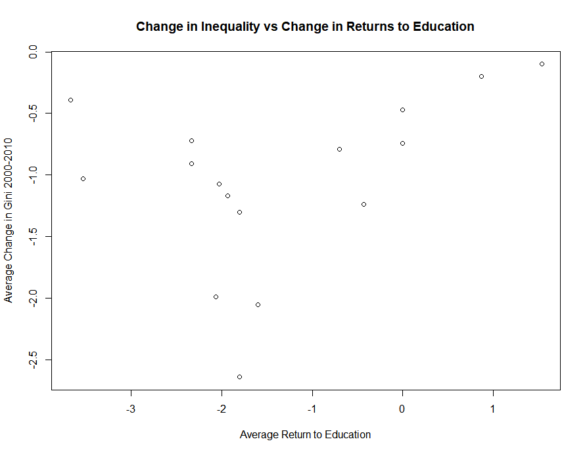
Inequality and education overview
Call:
lm(formula = x ~ y)
Y=Average Percent Change Gini
X=Average Percent Change Returns to Education (Tiers are Averaged)
Residuals:
Min 1Q Median 3Q Max
-1.109e-09 -6.983e-10 -1.860e-10 8.702e-10 1.257e-09
Coefficients:
Estimate Std. Error t value Pr(>|t|)
(Intercept) 1.472e-10 3.917e-10 3.760e-01 0.713
y 3.000e+00 9.425e-10 3.183e+09 <2e-16 ***
---
Signif. codes: 0 ‘***’ 0.001 ‘**’ 0.01 ‘*’ 0.05 ‘.’ 0.1 ‘ ’ 1
Residual standard error: 8.438e-10 on 14 degrees of freedom
Multiple R-squared: 1, Adjusted R-squared: 1
F-statistic: 1.013e+19 on 1 and 14 DF, p-value: < 2.2e-16

Slide 16
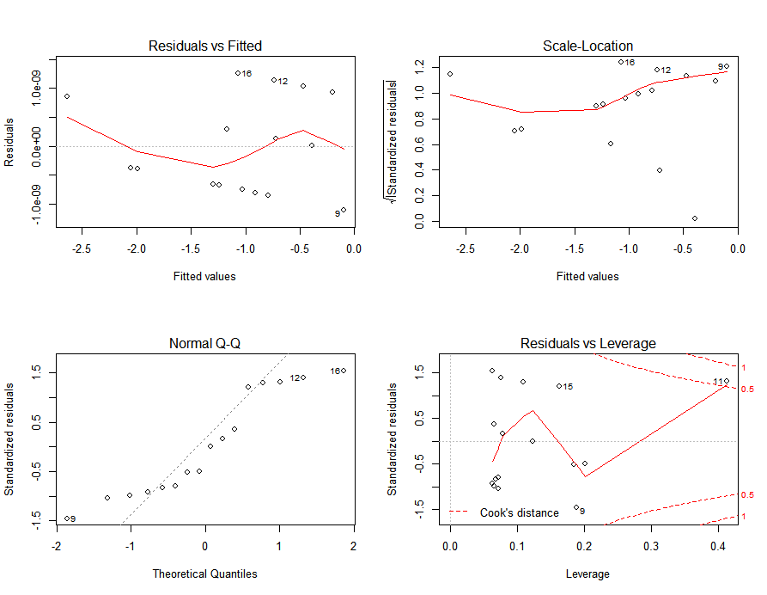
Inequality and education Continued

Slide 17
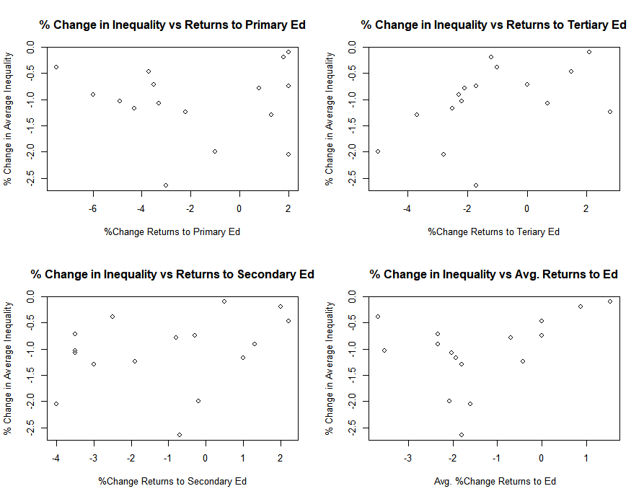
Inequality and education by tier

Slide 18
Inequality and Education by tier continued
Y=Average Gini Coefficient P=Average Return to Primary Education S=Average Return to Secondary Education T=Average Return to Tertiary Education X=Average Return to Education
lm(formula = y ~ P)
Residuals:
Min 1Q Median 3Q Max
-1.59374 -0.20242 0.06702 0.38725 0.96513
Coefficients:
Estimate Std. Error t value Pr(>|t|)
(Intercept) -1.057581 0.209537 -5.047 0.000178 ***
P -0.003773 0.058683 -0.064 0.949645
---
Signif. codes: 0 ‘***’ 0.001 ‘**’ 0.01 ‘*’ 0.05 ‘.’ 0.1 ‘ ’ 1
Residual standard error: 0.7178 on 14 degrees of freedom
Multiple R-squared: 0.0002952, Adjusted R-squared: -0.07111
F-statistic: 0.004134 on 1 and 14 DF, p-value: 0.9496
lm(formula = y ~ S)
Residuals:
Min 1Q Median 3Q Max
-1.6257 -0.1598 0.2316 0.3371 0.8078
Coefficients:
Estimate Std. Error t value Pr(>|t|)
(Intercept) -0.9430 0.1921 -4.910 0.00023 ***
S 0.1019 0.0835 1.221 0.24239
---
Signif. codes: 0 ‘***’ 0.001 ‘**’ 0.01 ‘*’ 0.05 ‘.’ 0.1 ‘ ’ 1
Residual standard error: 0.6825 on 14 degrees of freedom
Multiple R-squared: 0.09618, Adjusted R-squared: 0.03163
F-statistic: 1.49 on 1 and 14 DF, p-value: 0.2424
lm(formula = y ~ T)
Residuals:
Min 1Q Median 3Q Max
-1.5100 -0.3229 0.1510 0.3931 0.8516
Coefficients:
Estimate Std. Error t value Pr(>|t|)
(Intercept) -0.86351 0.18199 -4.745 0.000314 ***
T 0.15674 0.07651 2.049 0.059729 .
---
Signif. codes: 0 ‘***’ 0.001 ‘**’ 0.01 ‘*’ 0.05 ‘.’ 0.1 ‘ ’ 1
Residual standard error: 0.6297 on 14 degrees of freedom
Multiple R-squared: 0.2306, Adjusted R-squared: 0.1757
F-statistic: 4.197 on 1 and 14 DF, p-value: 0.05973
lm(formula = y ~ x)
Residuals:
Min 1Q Median 3Q Max
-1.5128 -0.2179 0.1208 0.4117 1.0657
Coefficients:
Estimate Std. Error t value Pr(>|t|)
(Intercept) -0.8111 0.2317 -3.501 0.00353 **
x 0.1756 0.1179 1.490 0.15853
---
Signif. codes: 0 ‘***’ 0.001 ‘**’ 0.01 ‘*’ 0.05 ‘.’ 0.1 ‘ ’ 1
Residual standard error: 0.667 on 14 degrees of freedom
Multiple R-squared: 0.1368, Adjusted R-squared: 0.07514
F-statistic: 2.219 on 1 and 14 DF, p-value: 0.1585
Notes:
Very few of the authors and papers surveyed directly mentioned trade in their explanations for the decline in inequality.

Slide 19
Inequality, Wage Premiums, Supply and Demand of Unskilled workers
country gini Wage premium % Change demand unskilled workers % Change supply unskilled workers
1 Argentina -1.30 -2.4 -4.7 2.40
2 Bolivia -2.05 -4.6 -8.7 5.10
3 Brazil -1.03 -3.2 -5.1 4.40
4 Chile -0.72 -1.9 -4.7 1.10
5 Costa Rica -0.47 -2.0 0.1 6.00
6 Dominican Republic -0.79 -0.2 2.8 3.40
7 Ecuador -1.99 -3.2 -6.3 3.40
8 El Salvador -1.24 -0.1 -0.5 -0.03
9 Guatemala -0.10 -1.9 -3.3 2.30
10 Mexico -1.17 -2.8 -6.3 2.20
11 Nicaragua -2.64 -6.9 -14.1 6.60
12 Panama -0.74 -2.6 -4.4 2.40
13 Paraguay -0.39 -5.6 -10.8 6.10
14 Peru -0.91 2.8 -4.6 3.80
15 Uruguay -0.20 -0.9 -1.4 1.10
16 Venezuela -1.07 -4.8 -10.3 4.20
Total % Change supply and demand unskilled workers
1 -2.30
2 -3.60
3 -0.70
4 -3.60
5 6.10
6 6.20
7 -2.90
8 -0.53
9 -1.00
10 -4.10
11 -7.50
12 -2.00
13 -4.70
14 -0.80
15 -0.30
16 -6.10
Notes:
Very few of the authors and papers surveyed directly mentioned trade in their explanations for the decline in inequality.

Slide 20
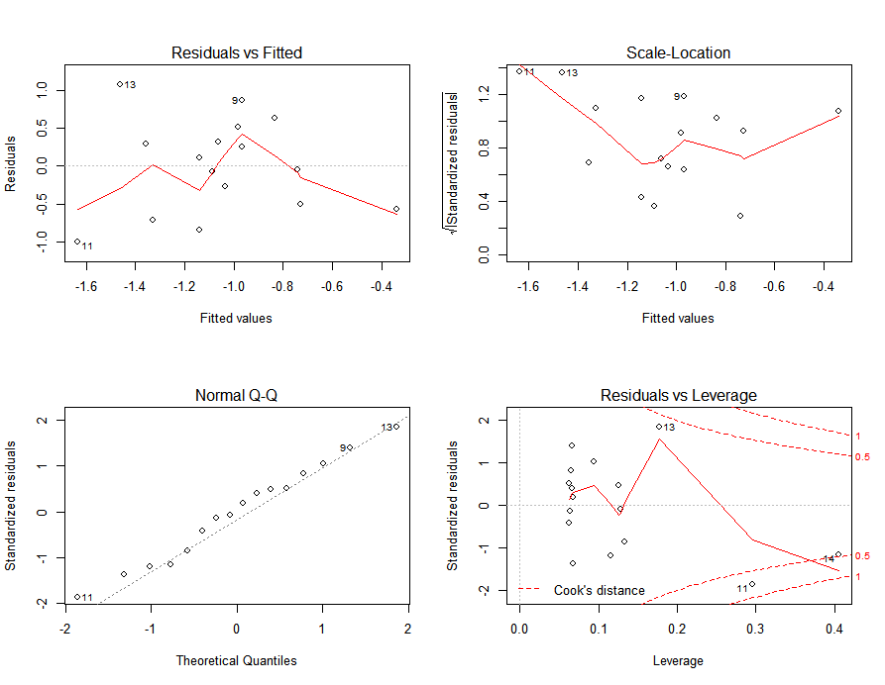
% Change Inequality vs % change wage premiums of unskilled workers
lm(formula = y ~ Wp)
Y= % Change Gini
Wp= % Change Wage Premium for Unskilled Workers
Residuals:
Min 1Q Median 3Q Max
-1.00351 -0.52726 0.03114 0.36893 1.07265
Coefficients:
Estimate Std. Error t value Pr(>|t|)
(Intercept) -0.71382 0.23915 -2.985 0.00984 **
Wp 0.13372 0.07053 1.896 0.07881 .
---
Residual standard error: 0.6404 on 14 degrees of freedom
Multiple R-squared: 0.2043, Adjusted R-squared: 0.1474
F-statistic: 3.594 on 1 and 14 DF, p-value: 0.07881
Notes:
Very few of the authors and papers surveyed directly mentioned trade in their explanations for the decline in inequality.

Slide 21
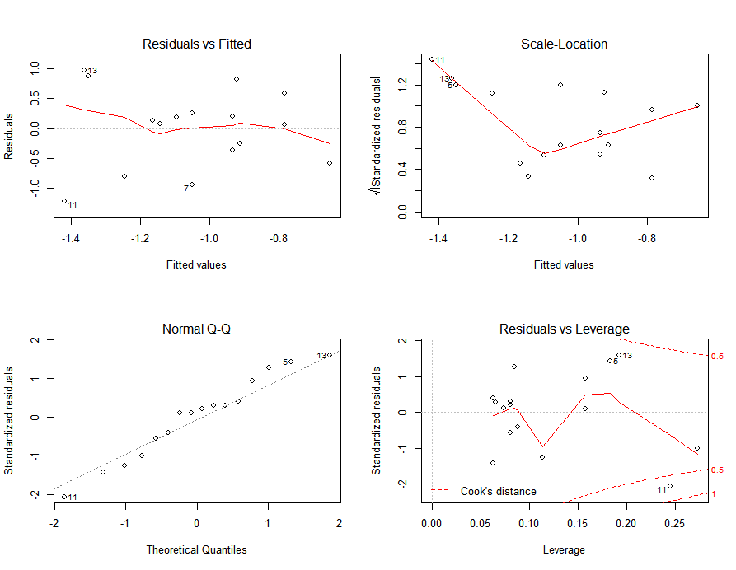
% Change Inequality vs % change supply of unskilled workers
lm(formula = y ~ %Changeinsupplyofunskilledworkers)
Residuals:
Min 1Q Median 3Q Max
-1.2205 -0.4204 0.1040 0.3412 0.9718
Coefficients:
Estimate Std. Error t value Pr(>|t|)
(Intercept) -0.65765 0.35292 -1.863 0.0835 .
Changeinsuppl-0.11543 0.09086 -1.270 0.2246
---
Residual standard error: 0.6798 on 14 degrees of freedom
Multiple R-squared: 0.1034,Adjusted R-squared: 0.03933
F-statistic: 1.614 on 1 and 14 DF, p-value: 0.2246
Notes:
Very few of the authors and papers surveyed directly mentioned trade in their explanations for the decline in inequality.

Slide 22
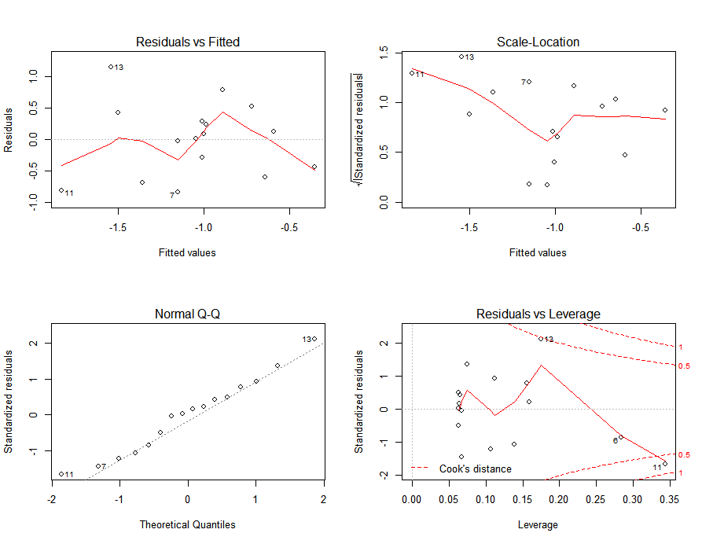
% Change Inequality vs % change Demand of unskilled workers
lm(formula = y ~ changeindemandofunskilledworkers)
Residuals:
Min 1Q Median 3Q Max
-0.83836 -0.47380 0.05496 0.32667 1.15478
Coefficients:
Estimate Std. Error t value Pr(>|t|)
(Intercept) -0.60124 0.23649 -2.542 0.0235 *
Changeindema 0.08736 0.03554 2.458 0.0276 *
---
Residual standard error: 0.6 on 14 degrees of freedom
Multiple R-squared: 0.3014, Adjusted R-squared: 0.2515
F-statistic: 6.041 on 1 and 14 DF, p-value: 0.02762
Notes:
Very few of the authors and papers surveyed directly mentioned trade in their explanations for the decline in inequality.

Slide 23
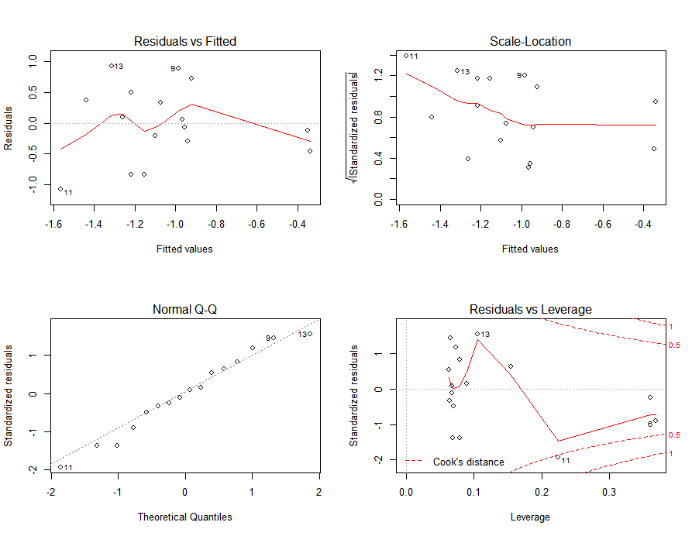
% Change Inequality vs % Total change supply and Demand of unskilled workers
lm(formula = y ~ TotalChangeinsupplyanddemandunskilledworkers)
Residuals:
Min 1Q Median 3Q Max
-1.07324 -0.33598 -0.00802 0.40283 0.92589
Coefficients:
Estimate Std. Error t value Pr(>|t|)
(Intercept)-0.89478 0.17516 -5.108 0.000159 ***
TotalChange 0.08960 0.04395 2.039 0.060836 .
---
Residual standard error: 0.6304 on 14 degrees of freedom
Multiple R-squared: 0.2289, Adjusted R-squared: 0.1738
F-statistic: 4.156 on 1 and 14 DF, p-value: 0.06084
Notes:
Very few of the authors and papers surveyed directly mentioned trade in their explanations for the decline in inequality.

Slide 24
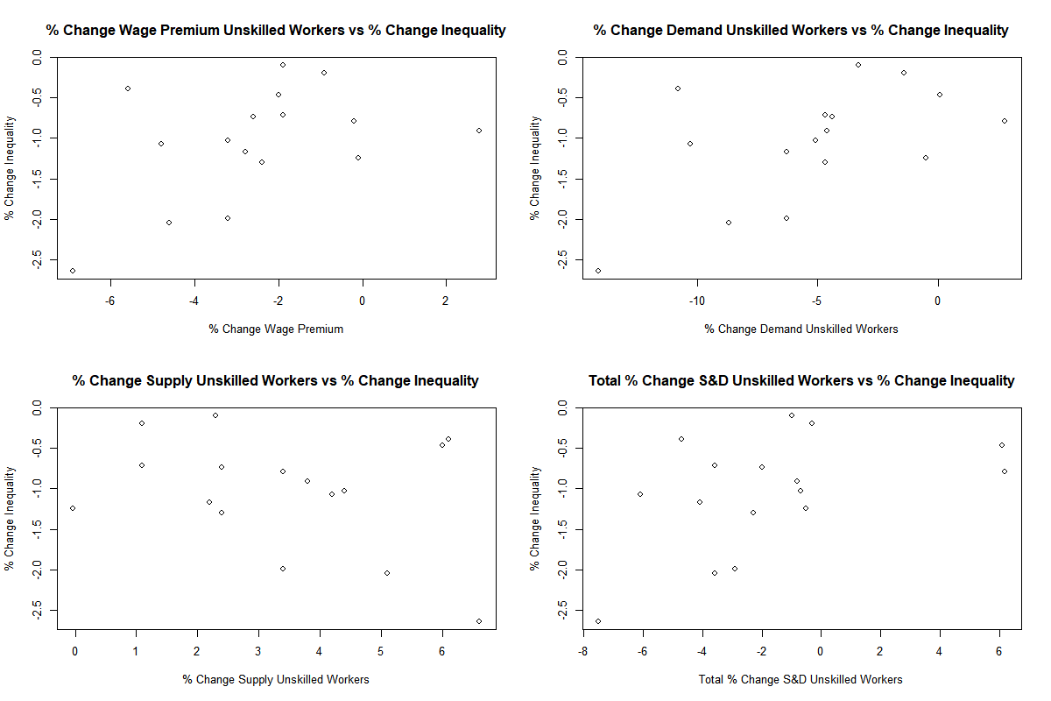
Inequality vs % change WP, Supply and Demand, total change supply and demand
Notes:
Very few of the authors and papers surveyed directly mentioned trade in their explanations for the decline in inequality.

Slide 25
Issues with Lustig’s analysis
Conclusions are drawn from a limited dataset.
17 countries rather than 26
Time frame makes some of her conclusions disputable today given advancements in technology and worldwide GDP growth.
It only looks at 1 specific measure of inequality (Gini) rather than multiple.
Analysis is more qualitative than quantitative and does not include enough regression based analysis.
None of the data is lagged.
Several of her conclusions were found to be false when recreated/
Trade and other external factors are left out.

Slide 26
Analysis Extension: Research question
Total trade, imports, and exports are a large indicator of how well an economy is performing on the world stage and directly impact GDP.
Highly indicative country’s level of development.
Therefore: Have total trade, total imports, and total exports significantly impacted income inequality in Latin America?

Slide 27
Overview of data
GINI Data from 1998-2013 from UNDP.
Trade data from WITS (World Integrated Trading Solution).
Developed by the World Bank in collaboration with the United Nations Conference on Trade and Development (UNCTAD))
Started out as totals (in thousands of U.S. dollars) for each variable and country by year and then was converted to logs using R.
Linear-log form:
Y =β₀ + β₁ln(x)+ ℇ
Notes:
Linear-log form
log-linear model is a mathematical model that takes the form of a function whose logarithm equals a linear combination of the parameters of the model, which makes it possible to apply (possibly multivariate) linear regression. in which the f_{i}(X) are quantities that are functions of the variables X, in general a vector of values, while c and the w_{i} stand for the model parameters.

Slide 28
Variables
Countries
GINI Coefficient
Country (15 total)
Year (from 1998 to 2013)
Total Trade
Total Imports
Total Exports
Argentina
Bolivia
Brazil
Chile
Columbia
Costa Rica
Dominican Republic
Ecuador
El Salvador
Honduras
Mexico
Nicaragua
Panama
Paraguay
Peru
Uruguay

Slide 29
Gini by country
Inequality Increased: Brazil, Honduras, Costa Rica
Inequality Declined: Argentina, Chile, Colombia, Dominican Republic, Ecuador, El Salvador, Mexico, Nicaragua, Uruguay
Inequality Declined Substantially: Bolivia, Paraguay, Peru, Panama
Notes:
Log linear form means the dependent variable is in its standard form and the independents are logged. In other words when your independent variable (s) goes up by 1% your dependent variables go up by the coefficient.

Slide 30
equations
Y (GINI)=β₀ + β₁lnTotal Trade+ ℇ
Y (GINI) =β₀ + β₁lnTotalExports+ ℇ
Y (GINI) =β₀ + β₁lnTotalImports+ ℇ
Notes:
Log linear form means the dependent variable is in its standard form and the independents are logged. In other words when your independent variable (s) goes up by 1% your dependent variables go up by the coefficient.
The reason why each independent variable was regressed by itself is due to (extremely high as 70 to 240) multicollinearity issues between the following groups: Total imports and total exports, total capital imports and total capital exports, and the remaining 5 variables. The lowest vif was 4. for capital imports and capital imports each vif was 6.

Slide 31
Overview of Data: Summary Statistics
Linear-Log Form
Monthly rather than annual (Lustig)
Note: Tables were exported from R to Excel by coding up a function similar to what is below
Variable | Observations | Mean | Std. Dev. | Min | Max
CountryID | 266 | 18.77 | 10.9 | 1 | 38
Year | 271 | 2005 | 4.9 | 1997 | 2013
GINI | 226 | 0.5 | 0.06 | 0.38 | 0.72
LogTotalTrade | 250 | 16.55 | 1.36 | 14.28 | 20.02
LogTotalExports | 250 | 14.64 | 1.74 | 11.01 | 18.55
LogTotalImports | 250 | 16.35 | 1.33 | 14.24 | 19.75
lmOut <- function(res, file="test.csv", ndigit=3, writecsv=T)
Notes:
Log linear form means the dependent variable is in its standard form and the independents are logged. In other words when your independent variable (s) goes up by 1% your dependent variables go up by the coefficient.

Slide 32
Impact of Total Trade on Inequality
Y (GINI)=β₀ + β₁lnTotal Trade+ ℇ
Dependent Variable: Income Inequality |  |  |  | Independent Variable: lnTotalTrade
Country | Observations | Coefficient | _Cons | Std. Error | t | P>|t| | R^2
Argentina | 16 | -0.0392 | 1.11 | 0.0052 | -7.5 | 0 | 0.801
Bolivia | 12 | -0.0666 | 1.57 | 0.0336 | -6.66 | 0 | 0.816
Brazil | 14 | -0.0036 | 0.64 | 0.01 | -0.36 | 0.724 | 0.011
Chile | 16 | -0.0422 | 1.25 | 0.011 | -3.83 | 0.002 | 0.512
Columbia | 11 | -0.0281 | 0.99 | 0.0063 | -4.48 | 0.002 | 0.691
Costa Rica | 16 | 0.0531 | -0.42 | 0.0138 | 3.83 | 0.002 | 0.512
Dominican Republic | 13 | -0.0369 | 1.05 | 0.0101 | -3.67 | 0.004 | 0.55
Ecuador | 14 | -0.0661 | 1.57 | 0.0113 | -5.86 | 0 | 0.741
El Salvador | 16 | -0.0324 | 0.98 | 0.015 | -2.16 | 0.048 | 0.251
Honduras | 13 | 0.0787 | -0.62 | 0.0223 | 3.53 | 0.005 | 0.531
Mexico | 16 | -0.0249 | 0.92 | 0.0084 | -2.94 | 0.011 | 0.382
Nicaragua | 7 | -0.0587 | 1.4 | 0.0224 | -2.63 | 0.047 | 0.58
Panama | 16 | -0.019 | 0.81 | 0.0054 | -3.49 | 0.004 | 0.565
Paraguay | 12 | -0.0414 | 1.21 | 0.01 | -4.07 | 0.002 | 0.624
Peru | 16 | -0.0135 | 0.76 | 0 | -3.12 | 0.008 | 0.41
Uruguay | 15 | -0.041 | 1.12 | 0.01 | -3.51 | 0.004 | 0.486
Notes:
The bottom is of the countries where inequality was significantly impacted by trade. Trade increased in all countries by about 336%.

Slide 33
Impact of Total Imports on Inequality
Y (GINI) =β₀ + β₁lnTotalImports+ ℇ
Dependent Variable: GINI |  |  |  | Independent Variable: lnTotalImports
Country | Observations | Coefficient | _Cons | Std. Error | t | P>|t| | R^2
Argentina | 16 | -0.0354 | 1.04 | 0.005 | -7.03 | 0 | 0.7791
Bolivia | 12 | -0.079 | 1.73 | 0.0111 | -7.11 | 0 | 0.835
Brazil | 14 | -0.0026 | 0.62 | 0.0094 | -0.28 | 0.782 | 0.007
Chile | 16 | -0.0413 | 1.23 | 0.0107 | -3.87 | 0.002 | 0.517
Columbia | 11 | -0.0262 | 0.96 | 0.0058 | -4.49 | 0.002 | 0.691
Costa Rica | 16 | 0.0498 | -0.36 | 0.013 | 3.82 | 0.002 | 0.51
Dominican Republic | 13 | -0.0253 | 0.86 | 0.009 | -2.82 | 0.017 | 0.419
Ecuador | 14 | -0.0643 | 1.53 | 0.0105 | -6.12 | 0 | 0.757
El Salvador | 16 | -0.0348 | 1.01 | 0.0181 | -1.92 | 0.075 | 0.209
Honduras | 13 | 0.08 | -0.63 | 0.0221 | 3.62 | 0.004 | 0.543
Mexico | 16 | -0.0236 | 0.89 | 0.0079 | -2.99 | 0.01 | 0.389
Nicaragua | 7 | -0.0698 | 1.56 | 0.0226 | -3.09 | 0.027 | 0.656
Panama | 16 | -0.0236 | 0.88 | 0.0066 | -3.56 | 0.003 | 0.475
Paraguay | 12 | -0.0413 | 1.21 | 0.0101 | -4.08 | 0.002 | 0.625
Peru | 16 | -0.0137 | 0.76 | 0.0045 | -3.06 | 0.009 | 0.4
Uruguay | 15 | -0.04 | 1.1 | 0.0113 | -3.56 | 0.004 | 0.493

Slide 34
Impact of Total exports on Inequality
Y (GINI) =β₀ + β₁lnTotalExports+ ℇ
Dependent Variable: Income Inequality |  |  |  | Independent Variable: lnTotalExports
Country | Observations | Coefficient | _Cons | Std. Error | t | P>|t| | R^2
Argentina | 16 | -0.0401 | 1.06 | 0.008 | -4.88 | 0 | 0.63
Bolivia | 12 | -0.0423 | 1.15 | 0.0081 | -5.2 | 0 | 0.73
Brazil | 14 | -0.0134 | 0.8 | 0.0133 | -1.01 | 0.331 | 0.331
Chile | 16 | -0.0481 | 1.25 | 0.0145 | -3.31 | 0.005 | 0.44
Columbia | 11 | -0.0373 | 1.1 | 0.0087 | -4.27 | 0.002 | 0.669
Costa Rica | 16 | 0.0707 | -0.58 | 0.0199 | 3.35 | 0.003 | 0.473
Dominican Republic | 13 | -0.0135 | 0.65 | 0.007 | -2 | 0.07 | 0.267
Ecuador | 14 | -0.0704 | 1.51 | 0.0166 | -4.24 | 0.001 | 0.6
El Salvador | 16 | -0.0213 | 0.77 | 0.008 | -266 | 0.018 | 0.337
Honduras | 13 | 0.0426 | 0.03 | 0.0207 | 2.06 | 0.064 | 0.2778
Mexico | 16 | -0.0293 | 0.97 | 0.0106 | -2.76 | 0.015 | 0.353
Nicaragua | 7 | -0.0241 | 0.81 | 0.014 | -1.72 | 0.147 | 0.371
Panama | 16 | -0.0081 | 0.62 | 0.0027 | -3.01 | 0.009 | 0.393
Paraguay | 12 | -0.0427 | 1.09 | 0.0118 | -3.62 | 0.005 | 0.567
Peru | 16 | -0.0112 | 0.7 | 0.0035 | -0.318 | 0.007 | 0.42
Uruguay | 15 | -0.0463 | 1.12 | 0.0145 | -3.19 | 0.007 | 0.439

Slide 35
Inequality and Trade Statistics
Countries where inequality is not impacted by….
Total Trade: Brazil
Total Exports: Brazil, Honduras, Nicaragua
Total Imports: Brazil, El Salvador, Nicaragua
Countries where the result is significant and an increase in X increases inequality….
Total Trade: Costa Rica, Honduras
Total Exports/Total Imports: Costa Rica
Countries where the result is significant and an increase in X decreases inequality….
Total Trade: Argentina, Bolivia, Chile, Colombia, Dominican Republic, Ecuador, El Salvador, Mexico, Nicaragua Panama, Paraguay, Peru, Uruguay
Total Exports: Argentina, Bolivia, Chile, Colombia, Dominican Republic, Ecuador, El Salvador, Mexico, Panama, Paraguay, Peru, Uruguay
Total imports: Argentina, Bolivia, Chile, Colombia, Dominican Republic, Ecuador, Honduras, Mexico, Panama, Paraguay, Peru, Uruguay
Notes:
The stats above also break down total imports and total exports. All countries that are not listed above for each variable saw inequality impacted by increases in the variable above (FOR the 1st STATEMENT)
Costa Rica are the only countries where an increase in the X variable saw an increase in Y and the result was signifigant

Slide 36
conclusion
14/15 Latin American countries surveyed trade had a statistically significant impact on inequality.
12/14 saw inequality decline as trade increased.
12/15 saw inequality decline as a result of increased total imports and total exports.
Based on the results, trade usually has a significant and positive impact on inequality.
For the most part, it does not matter whether you are importing more or exporting more. The key lies in higher total trade volume.
While authors such as Lustig and Perez focus on government transfers, education, gdp growth, and tax revenue, more research should be done pertaining to trade as an explanation for declining inequality given the results of this study.
Notes:
Manufactured, consumer, textiles did not help income inequality for many of the countries.

Slide 37
Future work
Code up and replicate more of Nora Lustig’s work.
Build out more complicated models with lags.
Add a larger time span and more Latin American countries into the dataset.
Potentially look at types or classifications of goods such as Capital Imports, Capital Exports, Raw Material Exports, Manufactured Goods Exports, Consumer Good Exports, Intermediate Good Exports, Textile Exports.
Optimize fit for each model.
Extension: Code up Gini Coefficient, Atkinson, and Theil Index using R.
Continuous probability distribution functions

