Slide 1
Application of Logistic Regression Model to Titanic Data
Jiawen Yang, Yiwen Zhou

Slide 2
Outline
Introduction
Analyze and Explore the Data
Prepare Data
Logistic Regression
Estimate Parameters
Code
Results

Slide 3
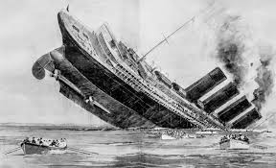
Introduction
On April 15, 1912, during her maiden voyage, the Titanic sank after colliding with an iceberg, killing 1502 out of 2224 passengers and crew.
Analyze and predict what sorts of people were likely to survive the tragedy.
Notes:
The sinking of Titanic is one of the most famous shipwrecks in history, killing about 2000 passengers on the ship. Since different passengers have different features. We try to find the correlation between different features and the survival rate and predict what sorts of people were more likely to survive the disaster.

Slide 4
Analyze and Explore the Data
Training Data
Testing Data
Notes:
We get the data from Kaggle website. By analyzing the training data, can our model predict whether the passenger in the testing data survived the disaster or not.

Slide 5
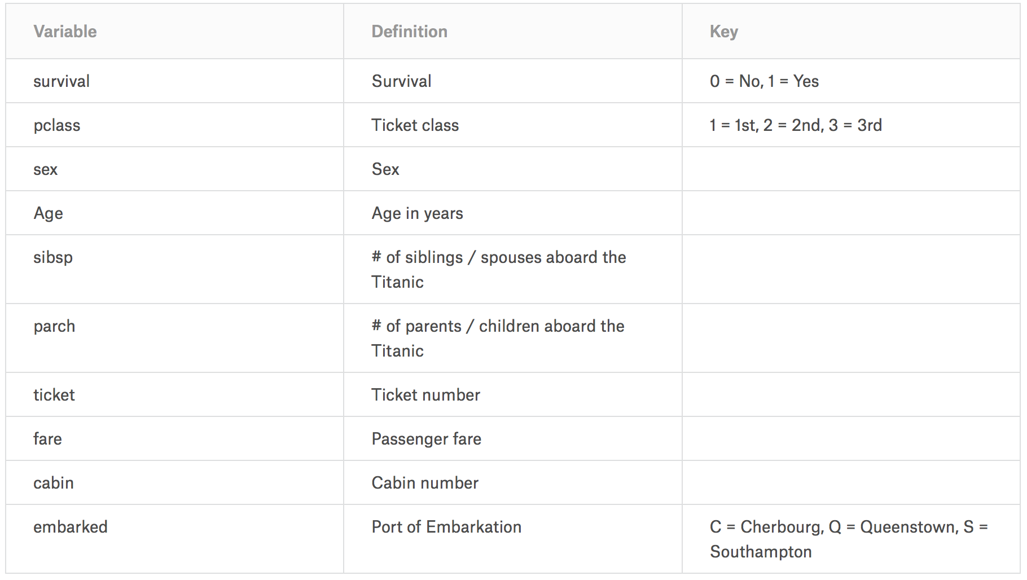
Analyze and Explore the Data
Notes:
Here are the available variables within the training dataset. These variables represent different features of the passengers, like Sex, Age and Ticket Class. Feature sibsp indicates how many siblings and spouses the passenger had aboard the ship. And feature parch indicates how many parents and children the passenger had on the ship. By analyzing the data, we want to understand the correlation of different features with our solution goal and determine which features are useful in modeling.

Slide 6
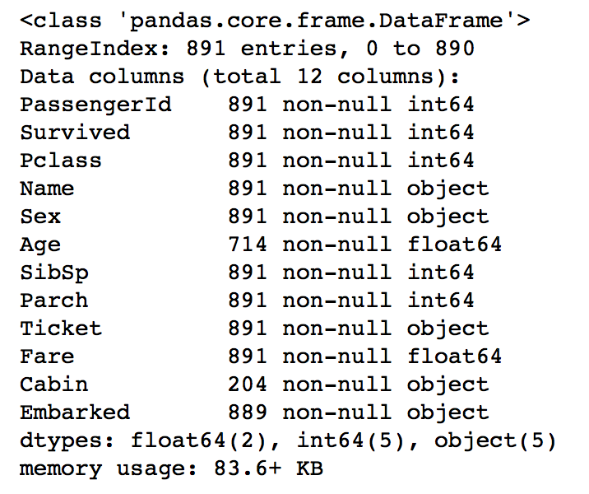
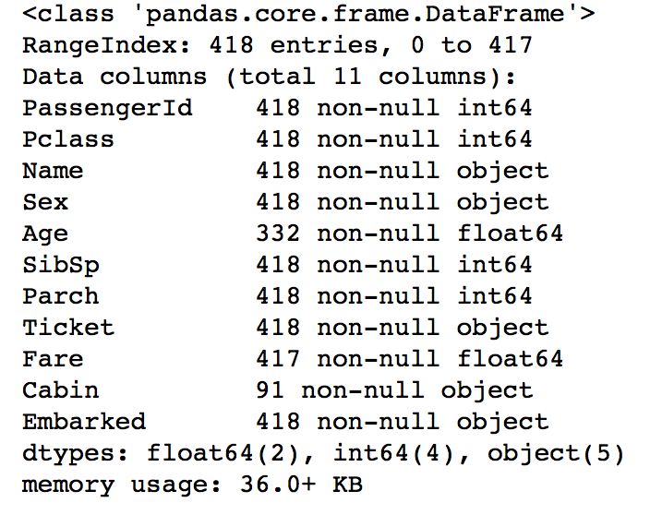
Analyze and explore the data
Analyze incomplete data
Training data
Testing Data
Notes:
First, we find that there are some missing values both in training and testing data sets. For the training data, from here, we can see the complete entries are 891. Most features are complete except Age,Cabin and Embarked. Cabin has nearly 700 missing values. So we may drop this feature since it contains too many null valus. Age has more than 100 values and Embarked has 2 missing values, which are not so much. So we may find a solution to complete these features. For the testing data, the complete entries are 418. Age feature has more than 100 missing values and Fare has 1 missing value. However, Cabin has more han 300 missing values, which we may drop. And for the Age and Fare feature, we can use some methods to complete them.

Slide 7
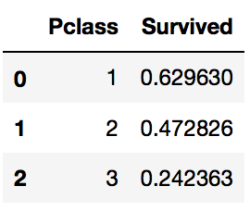
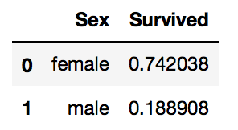
Analyze and Explore the Data
Analyze by pivoting features
Pclass
As the value of Pclass increasing, the probability of survival decreases.
Sex
The survival rate of female is higher than male.
Notes:
We can quickly analyze our feature correlations by pivoting features against each other. We can only do so at this stage for features which do not have any empty values. It also makes sense doing so only for features which are categorical type. The result shows that as the value of ticket class increasing, the passengers were likely to survive. And female are more likely to survive than male. It indicates that feature Pclass and Sex both contribute significantly to our solution goal.

Slide 8
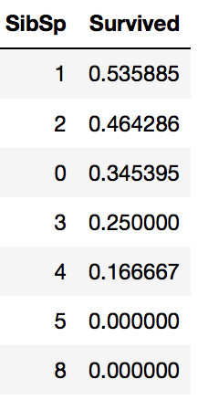
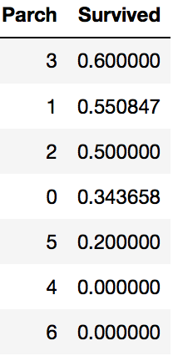
Analyze and Explore the Data
Analyze by pivoting features
SibSp and Parch
These features have zero correlation for certain values. It may be best to derive a feature or a set of features from these individual features.
Notes:
Feature SibSp and Parch don’t have an obvious correlation with survival rate. So we may consider deriving a new feature or a set of features from these variables.

Slide 9
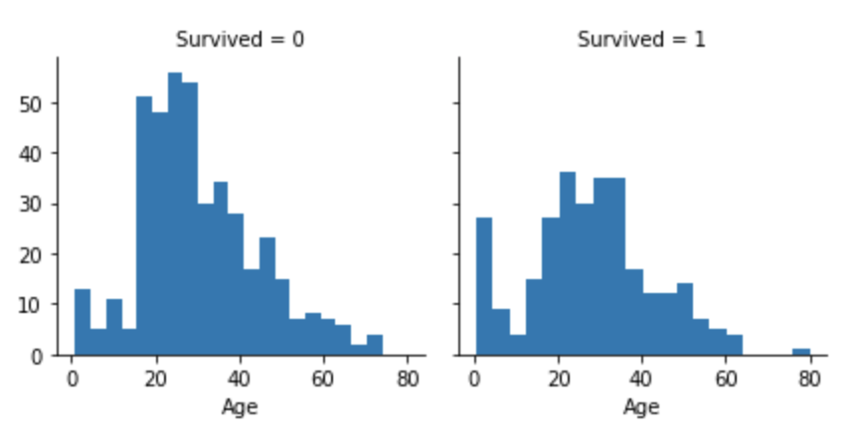
Analyze and Explore the Data
Analyze by visualizing data
Observations.
Infants (Age <=4) had high survival rate.
Oldest passengers (Age = 80) survived.
Large number of 15-25 year olds did not survive.
Most passengers are in 15-35 age range.
Notes:
Then we continue analyzing correlations between numerical features and survival rate by visualizing data. The plot shows that most passengers on the ship are between 15 to 30 years old, however, most of them didn’t survive. Infants had a survival rate. So we consider Age feature in our model training.

Slide 10
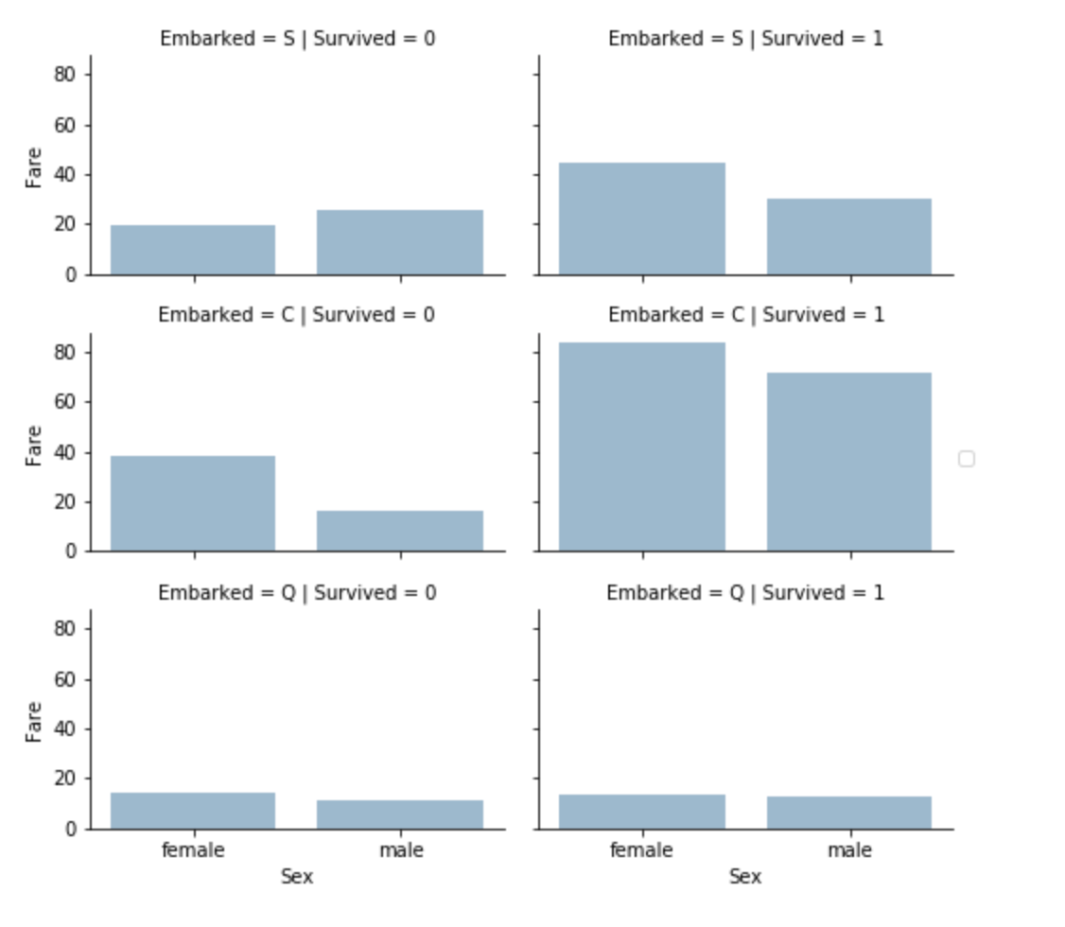
Analyze and Explore the Data
Observations.
Higher fare paying passengers had better survival.
Port of embarkation correlates with survival rates.
Notes:
Also, we can combine categorical and numerical features for identifying the correlations in one single plot. From this plot, we find that passengers who paid higher fare, are more likely to survive. And where passengers embarked also correlates to survival rate.

Slide 11
Analyze and Explore the Data
Observations.
Female passengers had much better survival rate than males.
Exception in Embarked=C where males had higher survival rate. This could be a correlation between Pclass and Embarked and in turn Pclass and Survived, not necessarily direct correlation between Embarked and Survived.
Males had better survival rate in Pclass=3 when compared with Pclass=2 for C and Q ports.
Ports of embarkation have varying survival rates for Pclass=3 and among male passengers.
Notes:
This plot shows that except the passengers who embarked in C port, female had higher survival rate than male. Maybe the reason for this situation is that the most male passengers embarked in C port had high class tickets. And we guess that the variable Embarked may be a lurking variable that does not affect survival rate directly but have a correlation with other features, like Pclass.

Slide 12
Analyze and Explore the Data
Conclusion
PassengerID
Pclass
Name
Sex
Age
Complete null values
Drop
Title
Age band
SibSp
Parch
Ticket
Fare
Cabin
Embarked
Complete null values
Drop
Drop (Null values)
Complete null values
Fare band
Create new features
Notes:
Here is the conclusion after analyzing the data. We decide to drop the PassengerID, Ticket and Cabin features. Because PassengerID and Ticket have none correlation with survival rate. And Cabin has too many missing values. And we want to extract a new feature Title from Name, because Name feature doesn’t provide much information for us. Also, we can create new features from sibSp and Parch variable since these two features don’t have a n obvious correlation with survival rate. And for other imcomplete feature, Age, Fare and Embarked, we will use some methods to complete them.

Slide 13
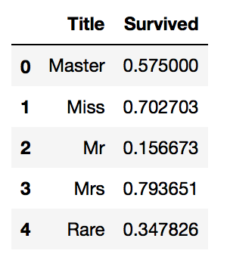
Prepare Data
Dropping Features:
Cabin
Ticket
PassengerId
Creating new feature extracting from existing:
Name Title
Notes:
Next step is to prepare the data to be modeled. First, we decide to drop the Cabin, Ticket number and PassengerID features since the previous analysis. Then we create a new feature Title extracting from name. Compares with name, The title feature gives us the information of the society status of different passengers, which is more helpful to build the model.

Slide 14
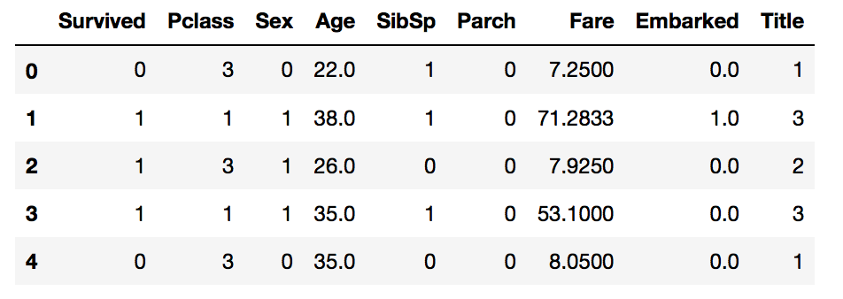
Prepare Data
Converting Features into Numerical Values
Sex
Female 1
Male 0
Title
Mr 1
Miss 2
Mrs 3
Master 4
Rare 5
Embarked
S 1
C 2
Q 3
Notes:
Next we convert some categorical features with alphanumeric data into numerical values to satisfy the model algorithm, like Sex, Title and Embarked.

Slide 15
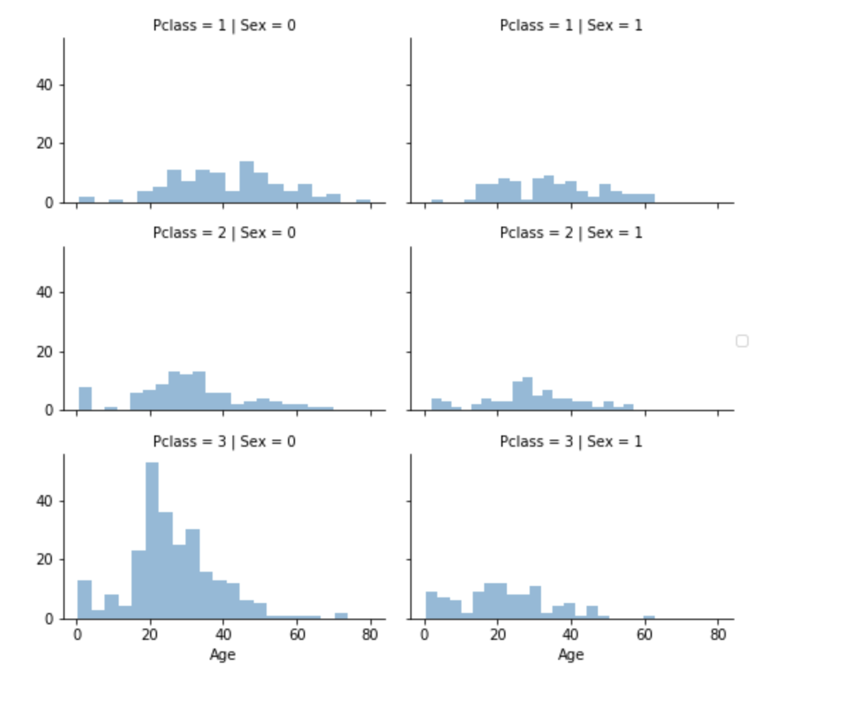
Prepare Data
Completing Features with missing values
Using median values for Age across sets of Pclass ☓ Sex.
Using the most common values for missing values in Embarked feature, and one single missing value in Fare feature and Title feature.
IsAlone
0
1
Notes:
We choose to use different methods to complete missing values. Using the most common values for missing values in Embarked, Fare and Title feature, since there is only one or two missing values in these features. The amount of missing values in Age feature is larger, so we choose to use a more accurate way to guessing the missing value. From this plot, we find that there is a correlation between Age, Pclass and Sex features. The combination of these features affect the survival rate. So we use median values for Age across set of Pclass and Sex feature combinations.

Slide 16
Creating new feature extracting from existing:
Convert Continuous Features into categorical Features
Age
1
2
3
4
5
Parch + SibSp + 1= FamilySize
$=1$
$>1$
IsAlone
0
1
Age-Band
$$≤16$$
$(16, 32]$
$(32, 48]$
$(48, 64]$
$>64$
Fare-Band
$$≤7.91$$
$(7.91, 14.454]$
$(14.454, 31]$
$$>31$$
Fare
1
2
3
4
Notes:
Then we create some new features by converting continous features into categorical features, like Age and Fare. And we extract Family size and IsAlone features from the Parch and SibSp featues to make our data more simple and clear.

Slide 17
Prepare Data
Result
Notes:
After the preparing stage, here is the final training data we used to build our model.
Then my friend Jiawen will introduce the logistic model and the result of prediction.

Slide 18
Logistic Regression
Observed Data:
$(x_{i}, y_{i})$, $x_{i}∈ℝ^{p}, y_{i}∈\{0, 1\}$
How x affects y?
$$y_{i} \sim Bernoulli(p_{i})$$
$$y(x)$$
$$p_{i}=1/(1+e^{x_{i}^{T}β})$$

Slide 19
Logistic Regression
$$y_{i} \sim Bernoulli(p_{i})$$
$$p_{i}=1/(1+e^{x_{i}^{T}β})$$
x: 'Pclass', 'Sex', 'Age', 'Fare', 'Embarked', 'Title', 'FamilySize', 'IsAlone'
$β:$ coefficient of x, unknown, estimate from data (x and y) (training set)
1,
$$p≥0.5$$
$$β, x$$
$$p_{ }$$
$$y=$$
0,
$$p<0.5$$

Slide 20
Logistic Regression
$$y_{i} \sim Bernoulli(p_{i})$$
$$p_{i}=1/(1+e^{x_{i}^{T}β})$$
How to estimate $β$ from the training set?
$$L(β|X,Y)=\prod_{i=1}^{n}{f\left(y_{i} | β, x_{i}\right)}=\prod_{i=1}^{n}{p_{i}^{y_{i}}{\left(1−p_{i}\right)}^{1−y_{i}}}$$
Likelihood:
$$\log{L\left(β | X, Y\right)=\sum_{i=1}^{n}{(y_{i}\log{p_{i}+\left(1−y_{i}\right)\log{(1−p_{i})}})}}$$
Log likelihood:
Maximize log likelihood

Slide 21
Estimate $β$
Maximize log likelihood
Gradient Ascent
Metropolis Hastings

Slide 22
Estimate $β$ -- Gradient Ascent
Intial guess: $β_{0}$
$$β_{n+1}=β_{n}+γ_{n}∇\log{L}$$

Slide 23
Estimate $β$ -- Metropolis Hastings
Flat prior: $π\left(β\right)=1$
$$u \sim Unif\left[0, 1\right]$$
Posterior: $π\left(β | X, Y\right)∝f(X,Y|β)π(β)=f(X,Y\left|β\right)=L(β|X,Y)$
$$n \sim normal distribution$$
Proposed update: $β_{n→n+1}=β_{n}+n$
If$π(β_{n→n+1}|X,Y)/π\left(β_{n}|X,Y\right)$ $≥u$, accept $β_{n→n+1}$by setting $β_{n+1}=β_{n→n+1}$
If$π(β_{n→n+1}|X,Y)/π\left(β_{n}|X,Y\right)$ $<u$, reject $β_{n→n+1}$ and set $β_{n+1}=β_{n}$ insetad

Slide 24
Code
$$y_{i} \sim Bernoulli(p_{i})$$
$$p_{i}=1/(1+e^{x_{i}^{T}β})$$
logistic(x, beta) compute $p_{i}$ for any $x_{i}$ and $β$
logistic_loglik(beta, X, Y) compute the log likelihood
logLgrad(beta, X, Y) compute the gradient of log likelihood
fitbeta_gradientascent(X, Y) fit $β$ with gradient ascent
fitbeta_metropolis(X, Y) fit $β$ with metropolis hastings
predict(beta, X) predict the survival information
accuracy(Y_predict, Y_train) compute the accuracy

Slide 25
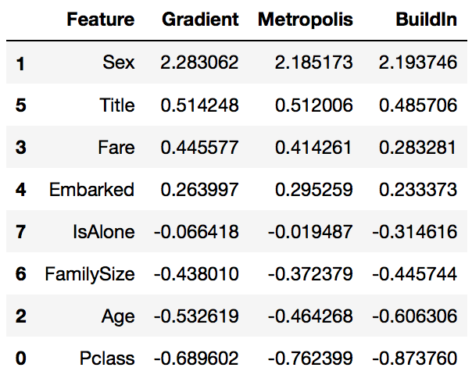
Results
Notes:
Sex is highest positivie coefficient, implying as the Sex value increases (male: 0 to female: 1), the probability of Survived=1 increases the most.
Inversely as Pclass increases, probability of Survived=1 decreases the most.

Slide 26
Thank you!

