Slide 1
von Mises Distribution Package
Presented by: Vedant Mehta
Kanchan satpute

Slide 2
Directional (circular) statistics
Type of data you use determines the kind of statistics to be used
Circular statistics should be used whenever you have a vector dataset
A vector dataset that has:
Angles
Periodicity
No true zero

Slide 3
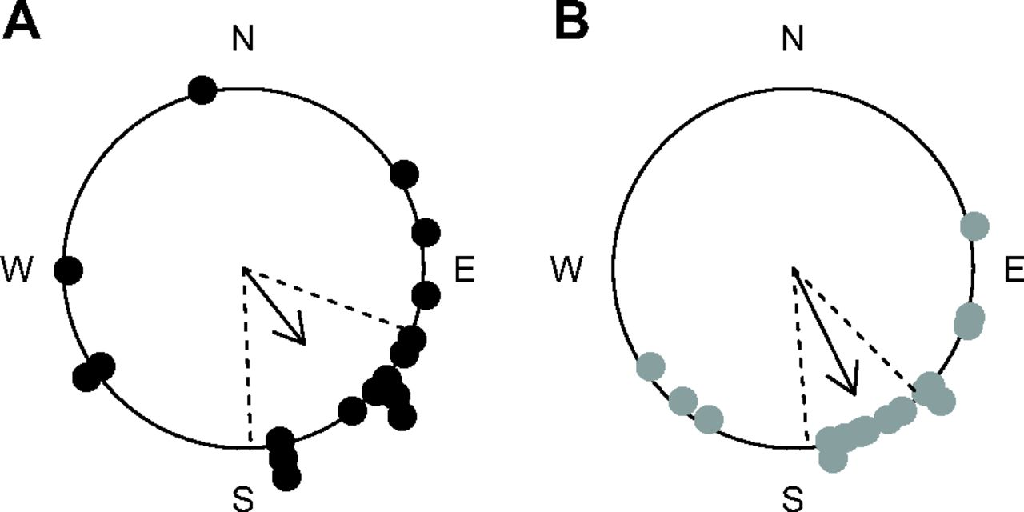
Circular Histogram of wind direction in hourly bins for that month
Departure direction of migratory birds

Slide 4
Mean and Median

Slide 5
Mean
Convert periodic data into an angular measurement:
$α= \frac{\left(2π\right)∗X}{k}$
X – value from the data, k – scale on which the data has been measured
Angular data must be converted to rectangular polar co-ordinates
$\cos{α}= \frac{x}{r}$ $\sin{a}= \frac{y}{r}$

Slide 6
Cont.
The mean angle can’t be calculated using linear mean formula
We use the following formula:
$Y= \frac{\sum_{i=1}^{n}{\sin{α}}}{n}$ $X= \frac{\sum_{i=1}^{n}{\cos{α}}}{n}$
$\overline{r}= \sqrt{X^{2}+Y^{2}}$

Slide 7
Cont.
Calculate the mean cosine and sine of X and Y obtained from the previous slide
$\cos{\overline{α}}= \frac{X}{r}$ $\sin{\overline{α}}= \frac{Y}{r}$
So mean angle would be:
$$θ_{r}=\arctan\left(\frac{\sin{\overline{α}}}{\cos{\overline{α}}}\right)$$

Slide 8
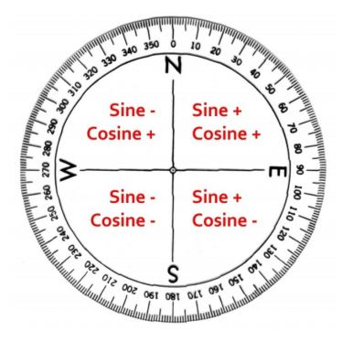
Cont.
Determining the quadrant:
Sin +, cos + : mean angle computed directly
Sin +, cos - : mean angle = $180 − θ_{r}$
Sin -, cos - : mean angle = $180+θ_{r}$
Sin -, cos +: mean angle = $360−θ_{r}$

Slide 9
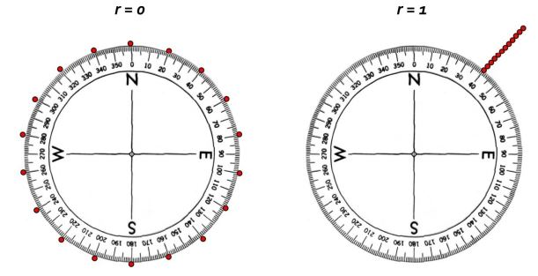
Variance
Circular variance measures variation in the angles about mean direction
It ranges from 0-1
Value of 1 means concentration in one direction
Value of 0 means equally dispersed around the circle

Slide 10
von Mises distribution
von Mises distribution in circular statistics is analogous to normal distribution in linear statistics
Probability density function is given by:
$$f\left(x | μ,κ\right)=\frac{1}{2πI_{o}(κ)}\exp\left[κ\cos{(x−μ)}\right]$$
$μ$ – measure of location
$κ$ – measure of concentration ( $1/κ$ is analogous to $σ^{2}$ )

Slide 11
PDF & CDF
PDF
CDF
If $κ$ is zero, the distribution is uniform
If $κ$ is large, the distribution becomes concentrated about the mean and approaches a normal distribution

Slide 12
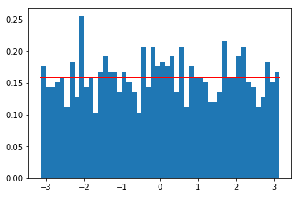
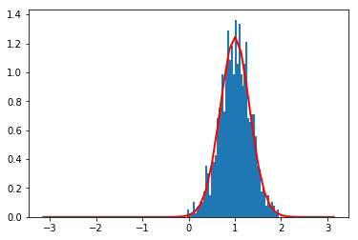
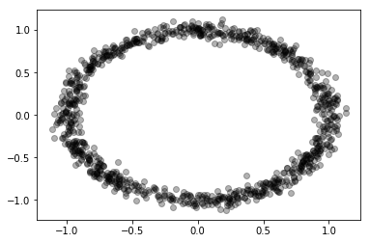
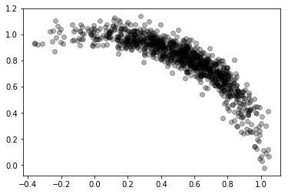
von Mises Representation
$$κ=0$$
$$κ=10$$

Slide 13
von Mises – R support
R has a popular package named “circular” which covers most of the functions for circular statistics (inclusive of von Mises distribution)
It also has another package named “CircStats” which has most of the basic functionalities of circular statistics covered
Python doesn’t have a very good support for circular statistics and von Mises distribution in specific

Slide 14
von Mises package
We have built a package “vonMises” for Python 3 and is available on PyPi
It consists of following functions:
rvonmises - Generate random deviates from vonMises distribution
dvonmises - Computes probability density on the basis of vonMises’ probability density function
pvonmises - Computes cumulative probability on the basis vonMises’ cumulative distribution function
qvonmises - Generates quantiles i.e., basically the inverse of vonMises cumulative distribution function

Slide 16
Methods
rvonmises( n, mu, kappa)
dvonmises(x, mu, kappa):- Default parameters: {log = False, class = “circular”}
pvonmises(q, mu, kappa):- Default parameters: {from_ = None, tol = np.exp(-20), log = False}
qvonmises(p, mu, kappa):- Defualt parameters: {mu = circular(0), kappa = None, from_ = None, tol = np.finfo(float).eps**0.6}
Common default parameters for all the functions: {type ="angles", units= "radians", template= "none", modulo= "asis", zero= 0, rotation= "counter“}

Slide 18
Results: R vs Python
Method | R | Python
pvonmises(2, 1, 6) pvonmises([2, 0.8], 2, 6) | [0.9888944] [0.5 , 0.003595458] | [0.988894] [0.5 , 0.00359546]
dvonmises(0.5, 1, 6) dvonmises([1, 3], 3, 6) | [0.4581463] [1.949157e-04, 9.54982e-01] | [0.45814625] [1.949157e-04, 9.54982e-01]
qvonmises(0.5, 1, 6) qvonmises([0.2, 0.6], 2, 7) | [1] [1.67413597, 2.09767203] | [1] [1.67413597, 2.09767203]

Slide 19
Random number generation
R (kappa = 1)
Python (kappa = 1)

Slide 20
Cont.
R (kappa = 6)
Python (kappa = 6)

Slide 21
Probability density
R
python

Slide 22
Cont.
R
python

Slide 23
Cumulative distribution

Slide 24
Benchmarking
Function | R | Python
rvonmises | 1.98 ms | 175 ms
dvonmises | 25 ms | 4 ms

Slide 25
Future scope
Making the package more robust to different kind of inputs
Optimize the code to decrease runtime
Include other functions of circular statistics, similar to “circular” package, under one hood

